Slide 1
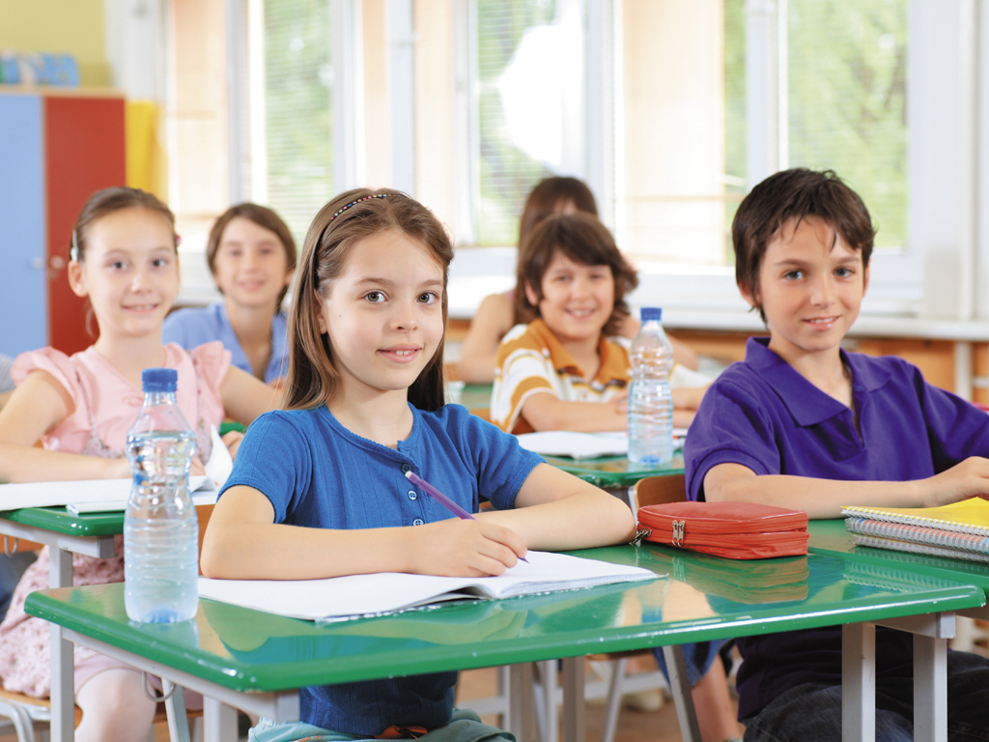
Classroom rules

Slide 2
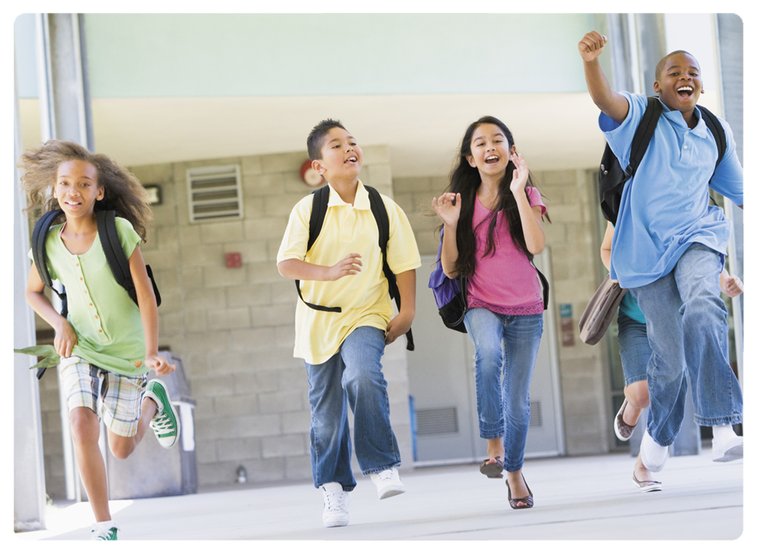
You _______ be late for school.
mustn’t

Slide 3
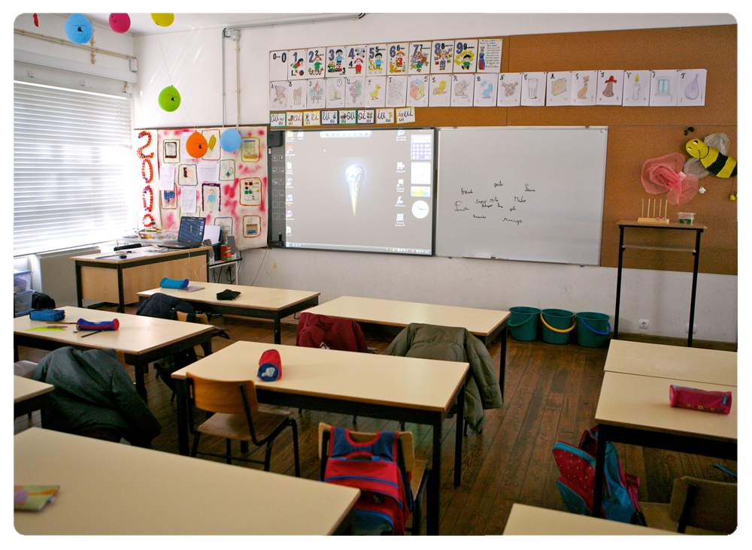
You _____ keep your classroom tidy.
must

Slide 4
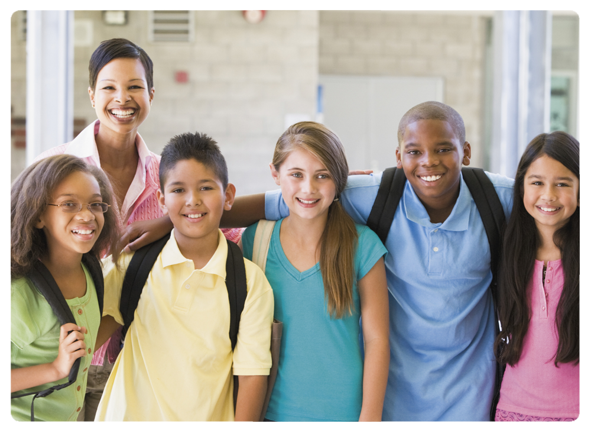
You _____ respect your classmates.
must

Slide 5

You _____ be quiet and listen to the teacher.
must

Slide 6

You ______ chew gum in class.
mustn’t

Slide 7
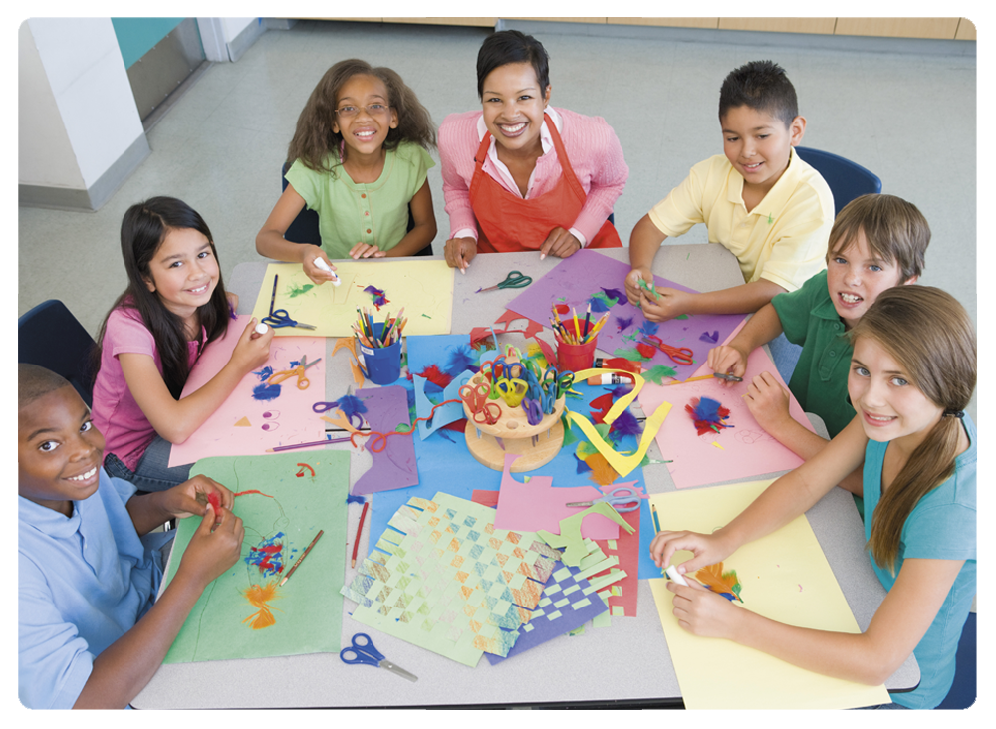
You _____ work as a team.
must

Slide 8

You _____ raise your hand to speak.
must

Slide 9

You _____ bring your books to school.
must

Slide 10

You ______ fight!
mustn’t

Slide 11
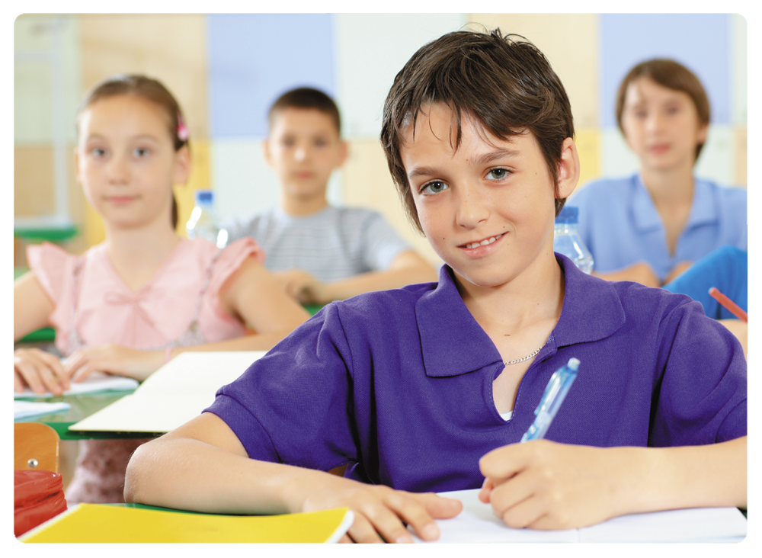
You _____ pay attention in lessons.
must

Slide 12
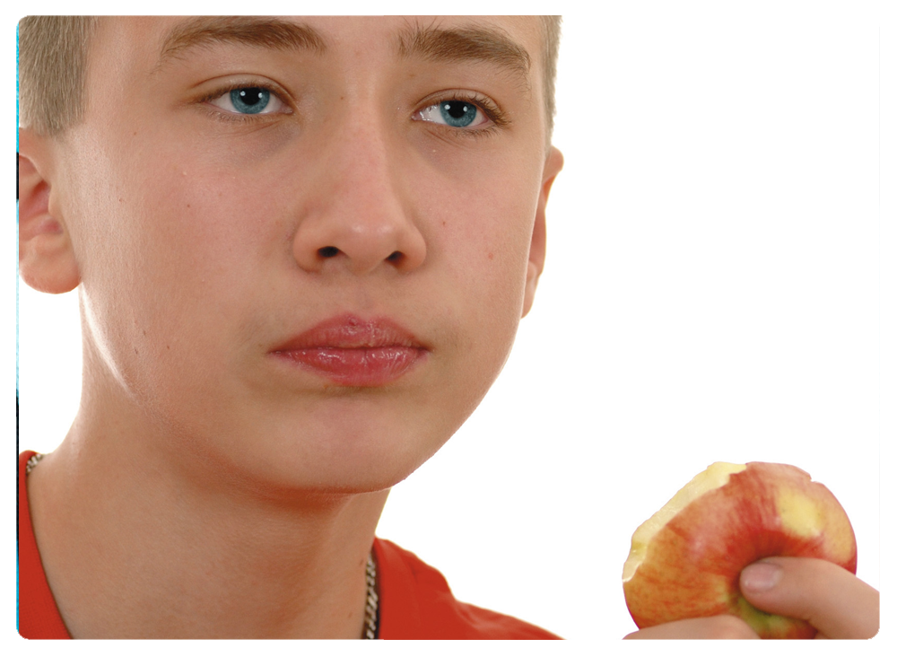
You ______ eat in class.
mustn’t

Slide 13
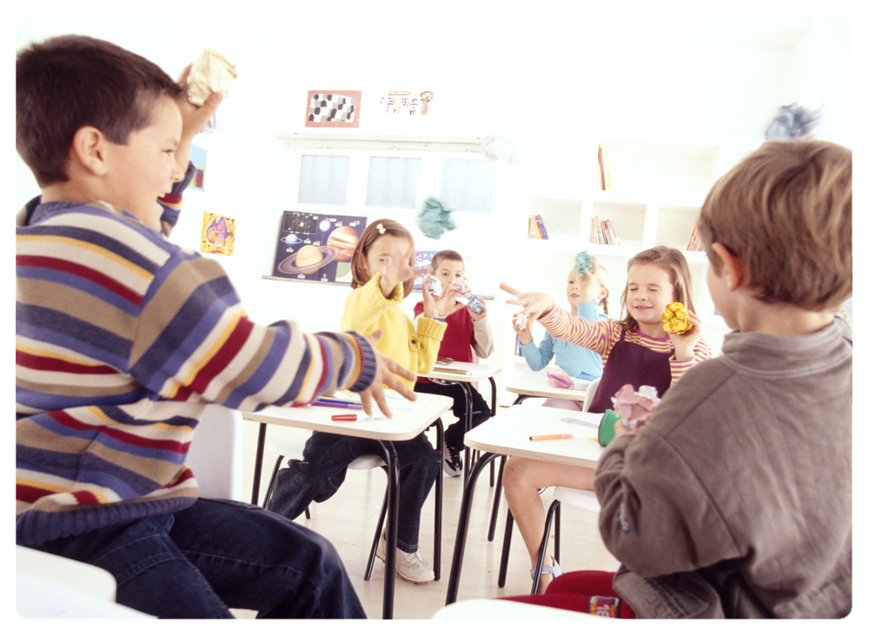
You ______ throw paper.
mustn’t

Slide 14
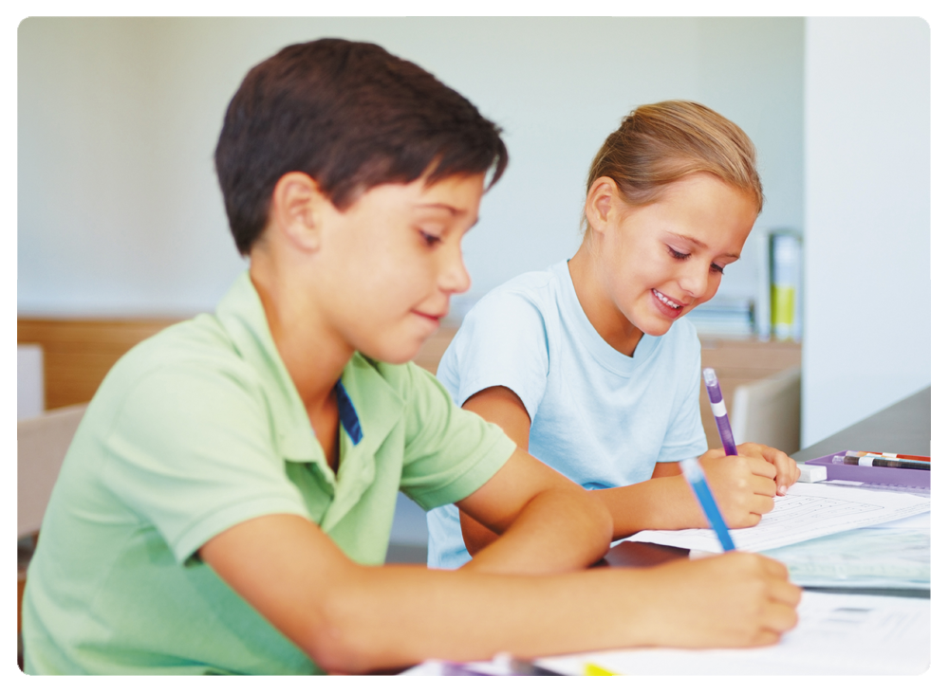
You _____ do your homework.
must

Slide 15
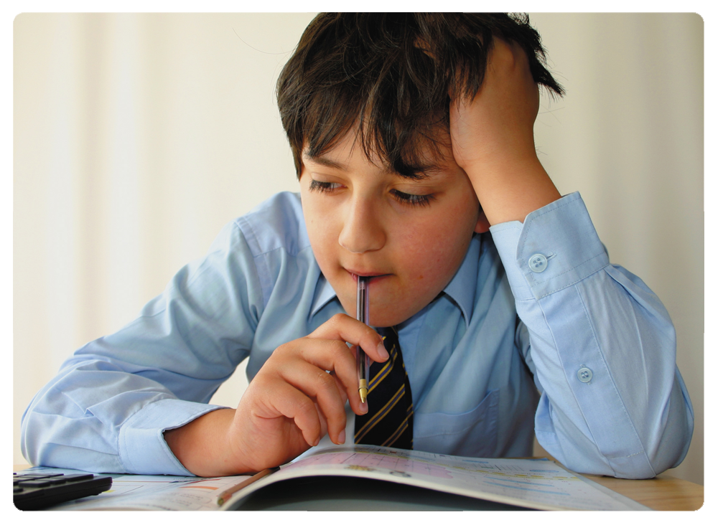
You ____ study hard!
must

Slide 16
Classroom rules

