Slide 1


Slide 2
We use the past continuous to talk about actions in progress at a certain time in the past.

Slide 3
Form:
was, were
+
main verb + ing

Slide 4
Affirmative
I | was | playing dancing studying
He, she, it | was
We, you, they | were

Slide 5

was riding
Ann __________ (ride) her bike.

Slide 6
Interrogative
Was | I | playing? dancing? studying?
Was | he, she, it
Were | we, you, they

Slide 7
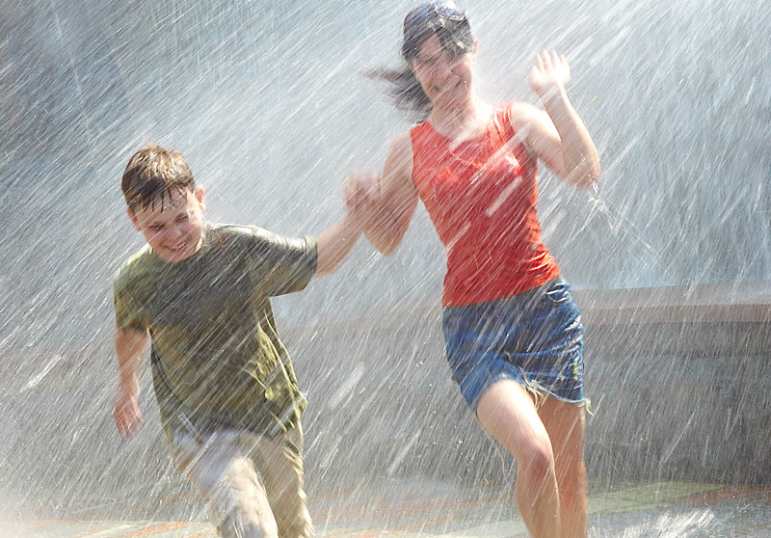
Was it raining?
Yes, it was.

Slide 8

Were the children swimming?
No, they weren’t. They were reading.

Slide 9
Negative
I | wasn’t | playing dancing studying
He, she, it | wasn’t
We, you, they | weren’t

Slide 10

We weren’t drawing.
We were painting.

Slide 11
What were these people doing at 5 o’clock?

Slide 12

Tess _____________ (listen) to music.
was listening

Slide 13

They _____________ (work).
were working

Slide 14

Daisy __________ (do) her homework.
was doing

Slide 15
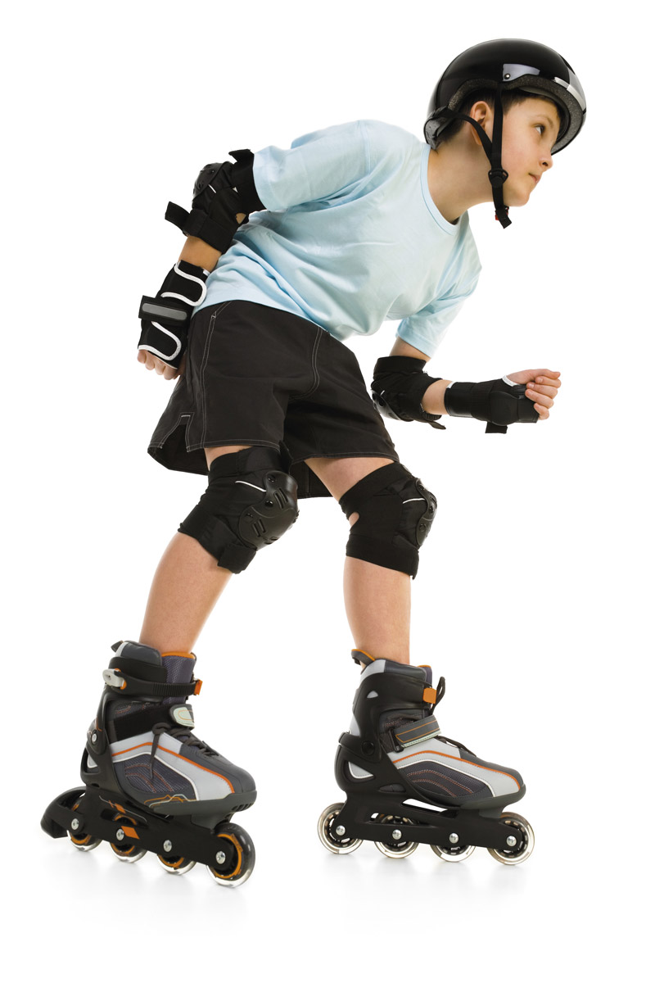
David ________________ (rollerblade).
was rollerblading

Slide 16
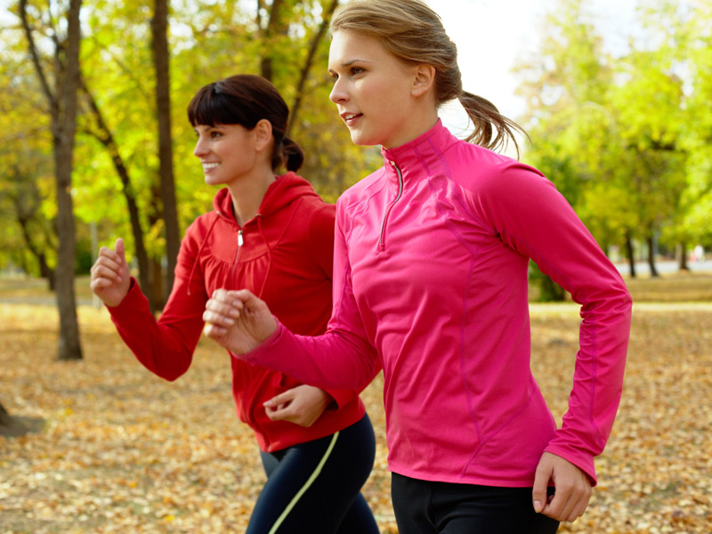
Emily and Eve ____________ (jog).
were jogging

Slide 17
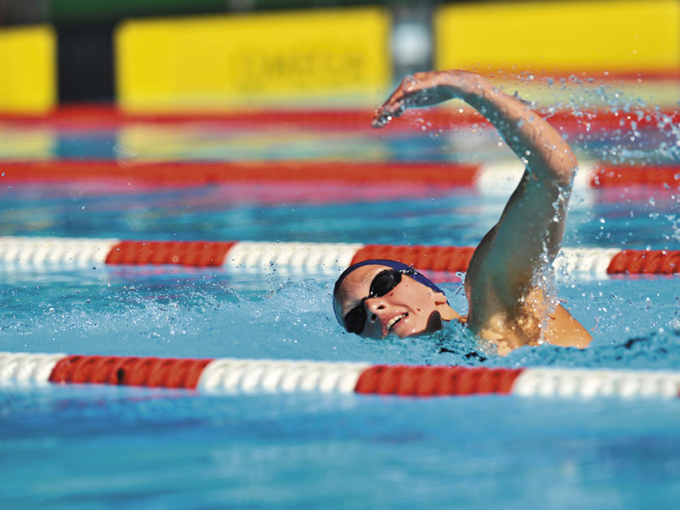
You were _______________ (swim).
were swimming

Slide 18
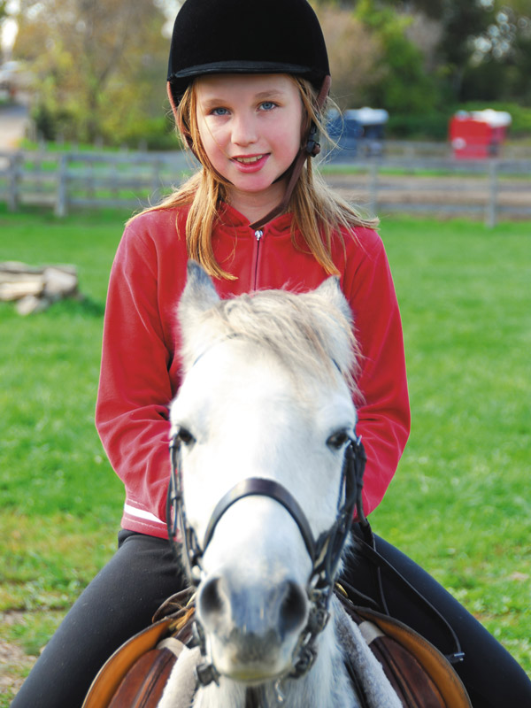
I __________ (ride) my horse.
was riding

Slide 19
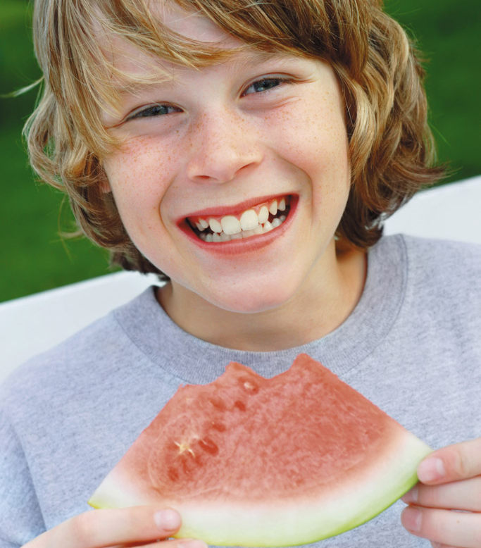
Bill __________ (eat) a slice of watermelon.
was eating

