Slide 1
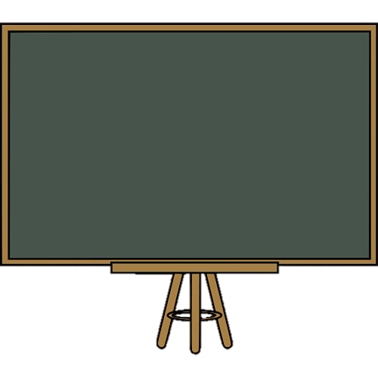
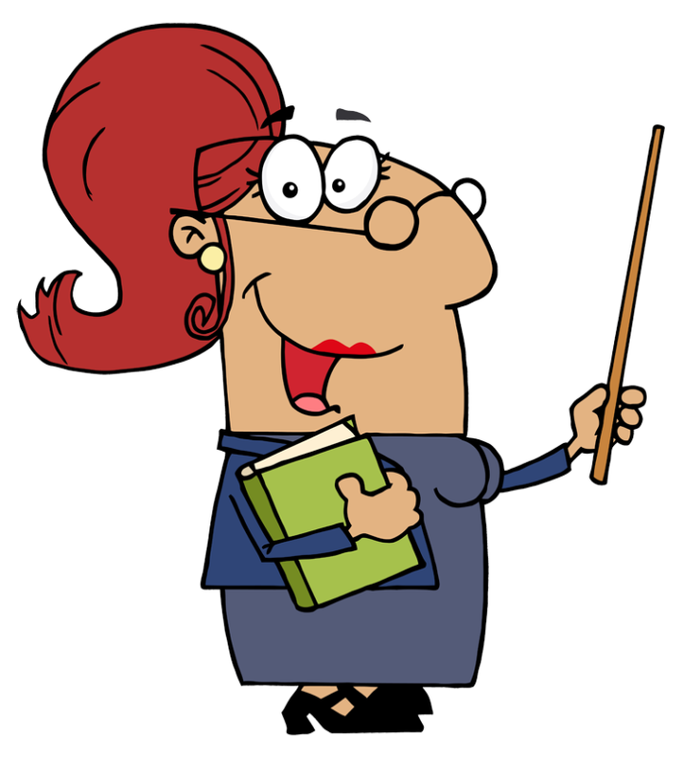

Past Simple
Regular verbs

Slide 2
We use the past simple to talk about things that happened in the past.

Slide 3
Time expressions:
Yesterday
last week/month/year
a year ago
the day/week before
in 2010…

Slide 4
Affirmative
I | played
He, she, it | played
We, you, they | played

Slide 5
Spelling rules
Infinitive + ed/d | visit – visited love – loved
Vowel + y: ed | enjoy – enjoyed
Consonant + y: ied | study – studied
One-syllable verb 1 vowel + 1consonant: Double consonant + ed | stop – stopped bat – batted
Two-syllable with stress on second syllable and ending with a single consonant: Double consonant + ed | permit – permitted commit – committed

Slide 6
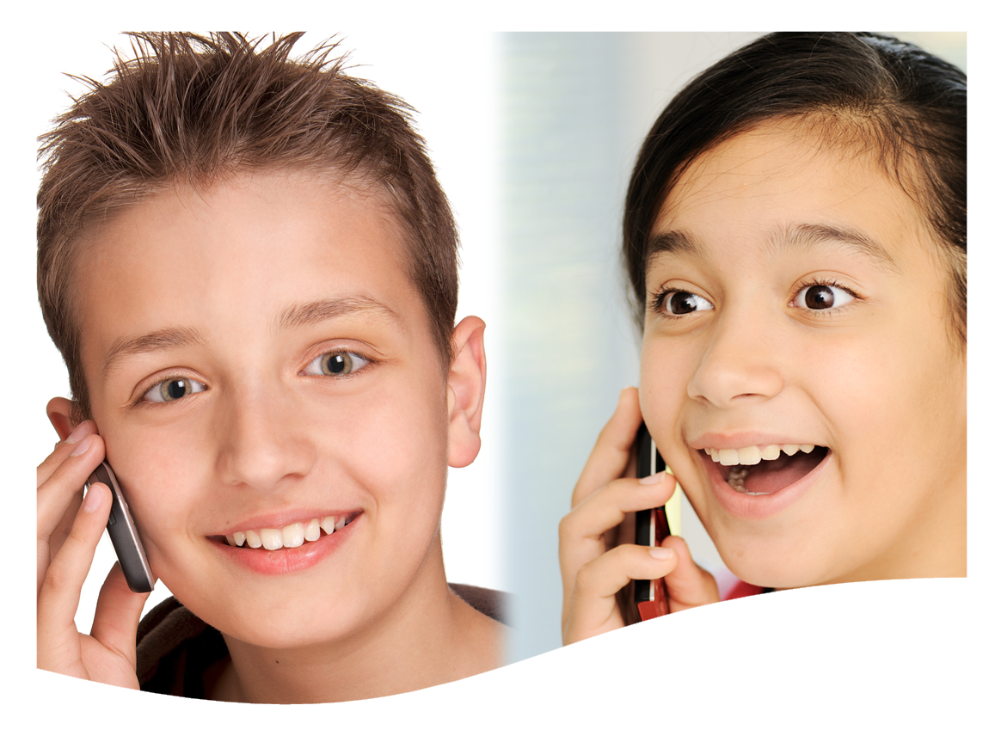
Tom phoned his best friend.

Slide 7
Negative
Subject + didn’t + infinitive
I | didn’t | play work Watch
He, she, it | didn’t
We, you, they | didn’t

Slide 8
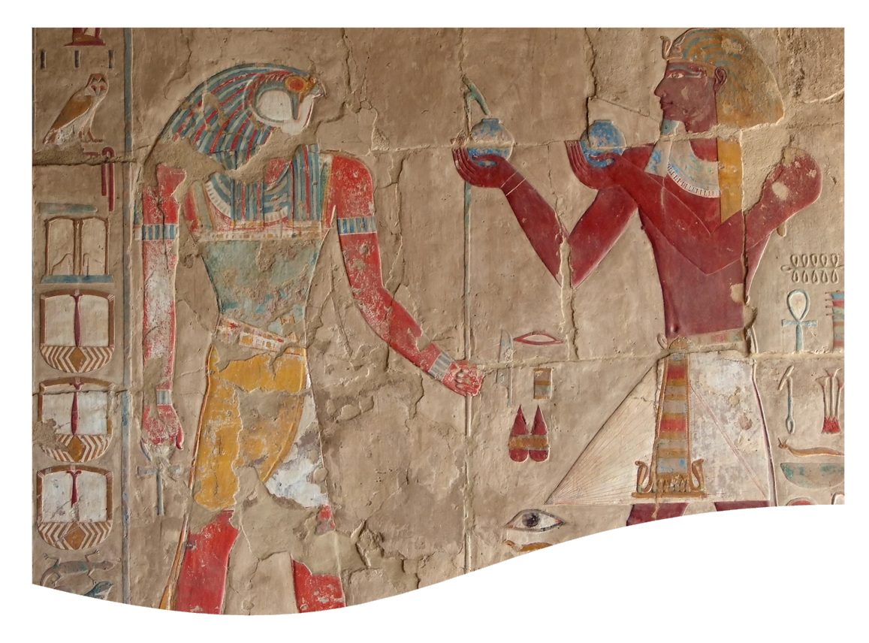
They didn’t study for the Maths test.
They studied for the History test.

Slide 9
Interrogative
Did + subject + infinitive
Did | I | play? work? like?
Did | he, she, it
Did | we, you, they

Slide 10
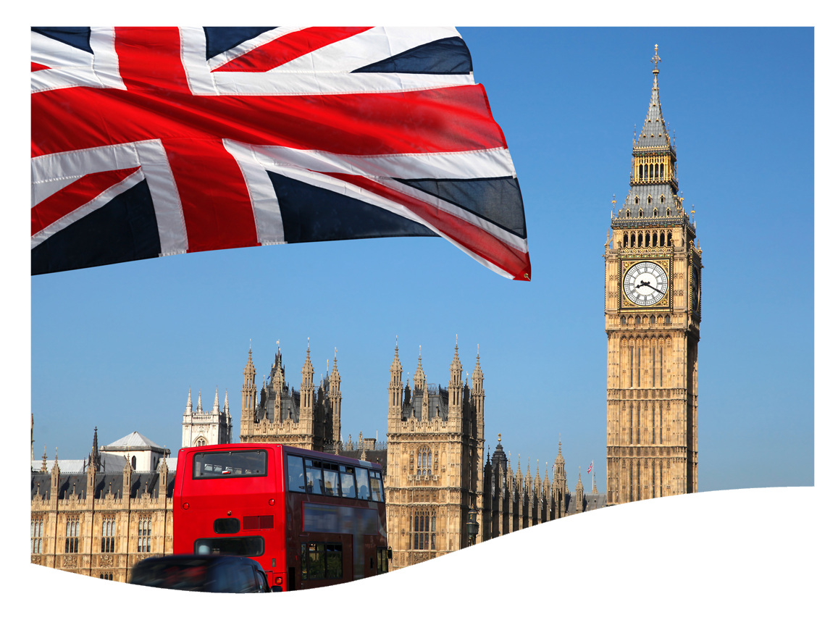
Did they visit London last year?
Yes, they did.

Slide 11

Did Jack cycle to school?
No, he didn’t

Slide 12
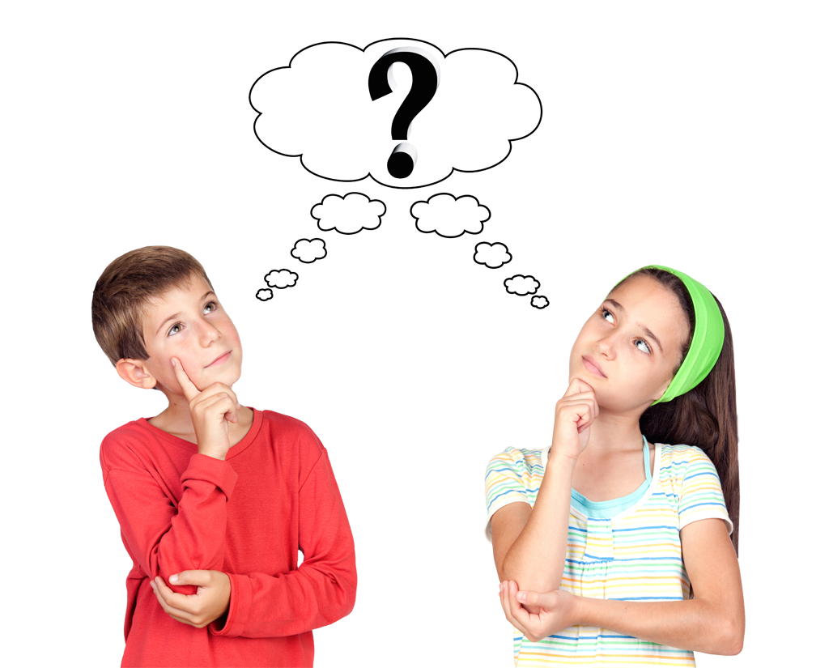
Grammar practice
Look at the pictures and make true sentences. Use the past simple.

Slide 13
Follow the example.
They / ask a question.
Did they ask a question?
Yes, they did. They asked a question.
No, they didn’t.

Slide 14

Emily / visit / the Coliseum in Rome.
Did Emily visit the Coliseum in Rome?
Yes, she did. She visited it.

Slide 15
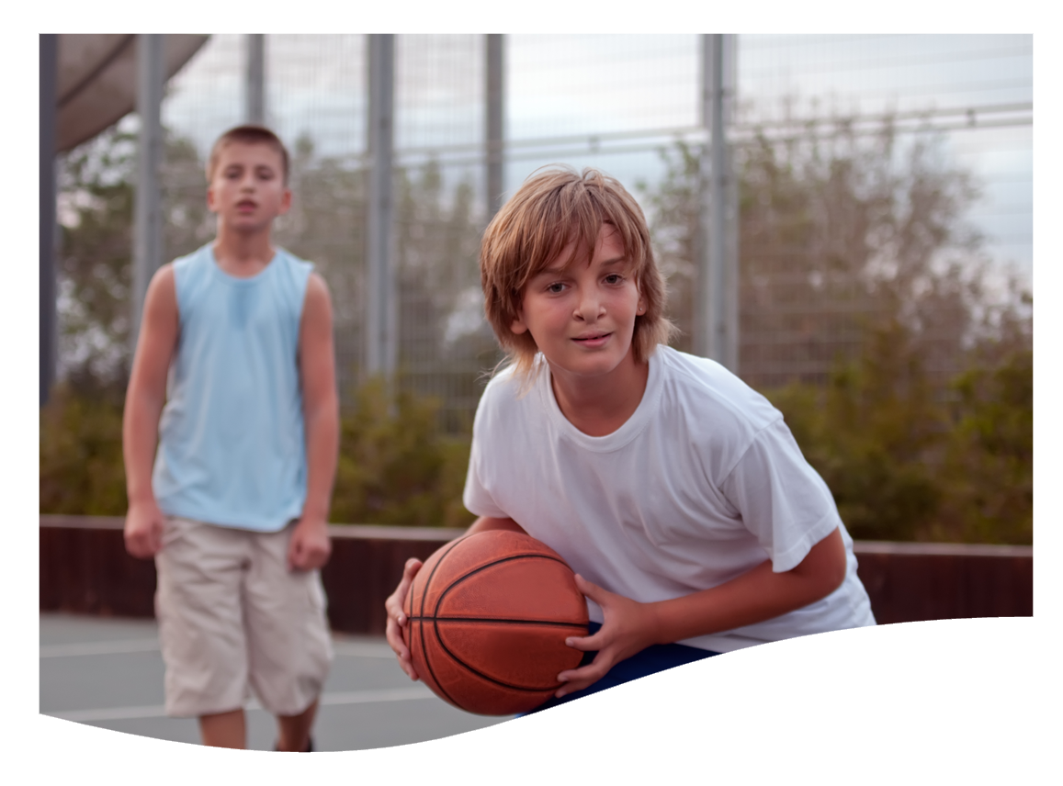
They / play / football in the morning.
Did they play football in the morning?
No, they didn’t. They played basketball.

Slide 16

We / dance / a lot last Saturday.
Did we dance a lot last Saturday?
Yes, we did. We danced a lot.

Slide 17

Bill / study / hard
Did Bill study hard?
Yes, he did. He studied hard.

Slide 18
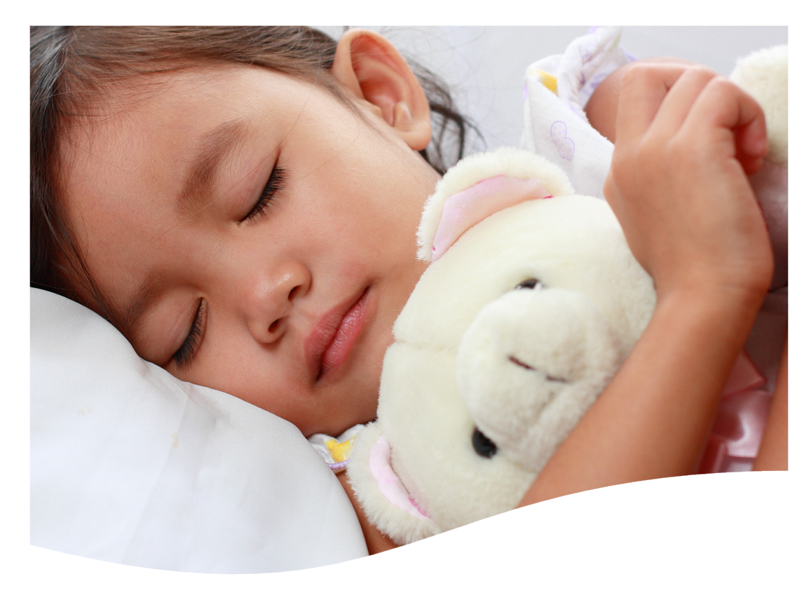
Daisy / stay / in bed late
Did Daisy stay in bed late?
Yes, she did. She stayed in bed late.

Slide 19
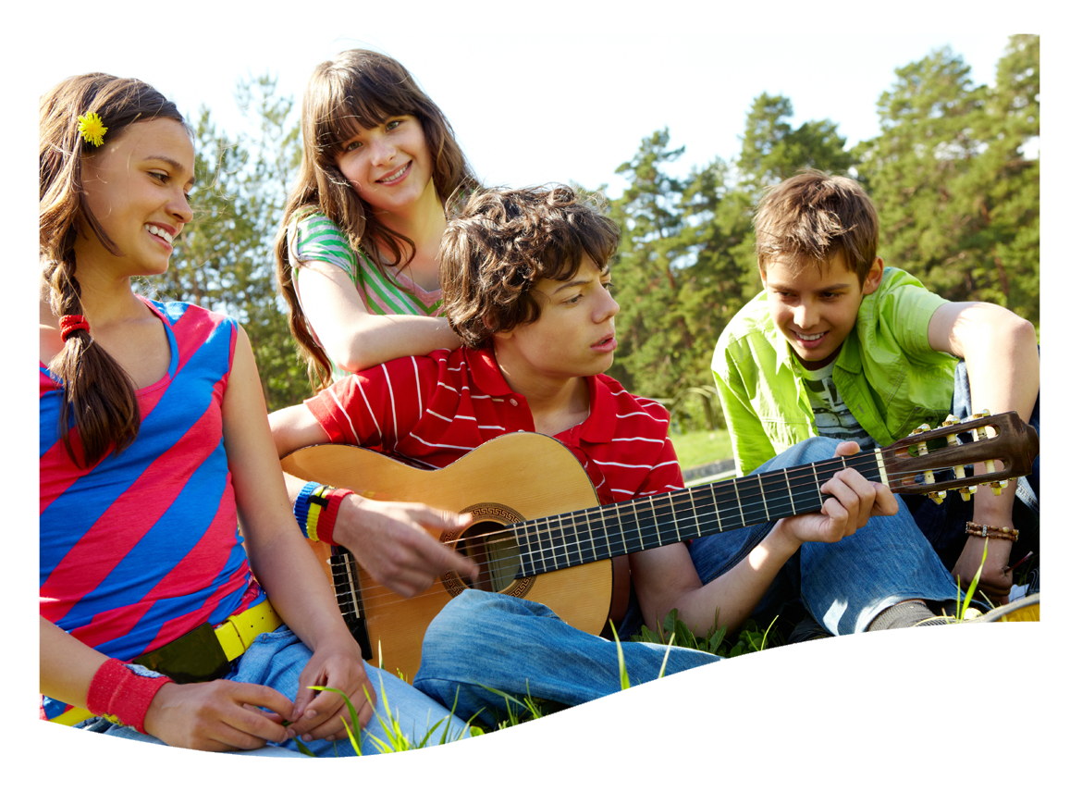
My cousin / play / the piano
Did my cousin play the piano?
No, he didn’t. He played the guitar.

Slide 20

Henry / smile / at me
Did Henry smile at me?
Yes, he did. He smiled at me.

