Slide 1
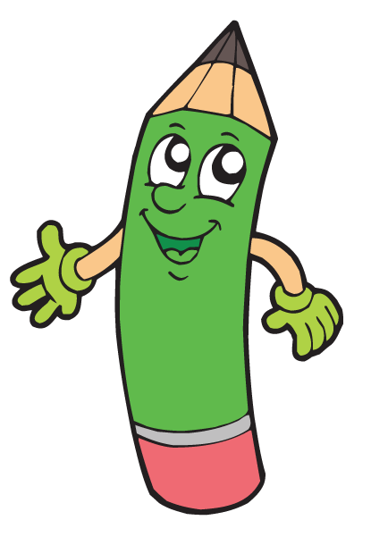
Plural of nouns

Slide 2
Rules
To make the plural we usually add –s to the noun.
book → books
pen → pens
Nouns ending in consonant + y → ies.
country → countries
baby → babies
But
vowel+ y → s
boy → boys
Nouns ending in –s,
-sh, -ch, -x and some nouns ending in –o → es.
class → classes
box → boxes
watch → watches
tomato → tomatoes
Most nouns ending in –f or
–fe → ves.
knife → knives
leaf → leaves

Slide 3
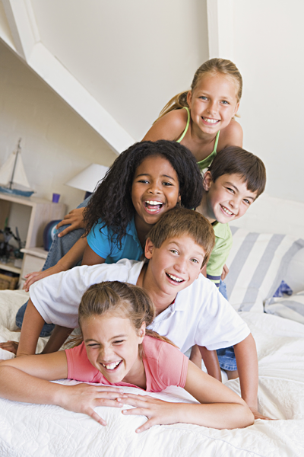
Irregular plurals
person → people
man → men
woman → women
child → children
foot → feet
tooth → teeth
mouse → mice
fish → fish
sheep → sheep

Slide 4
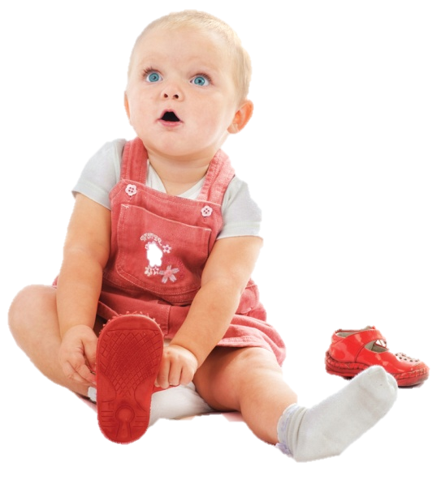
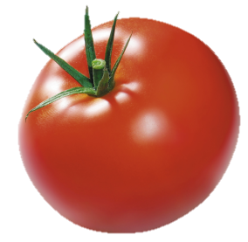

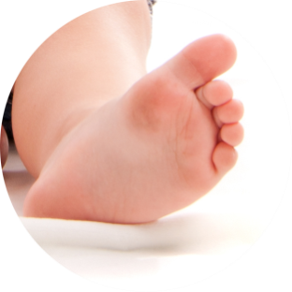
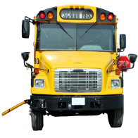
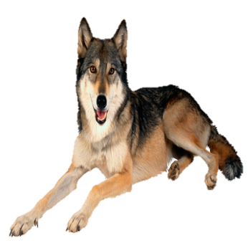
Let’s play!
foot
tomato
brush
wolf
baby
bus
PLAY

Slide 5
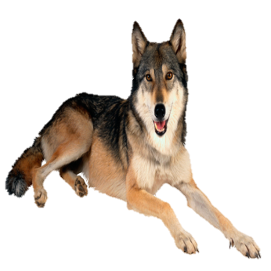
What's the plural of wolf?
GOOD JOB!
one wolf
two
wolves
WOLFES
WOLVES
WOLFESES

Slide 6
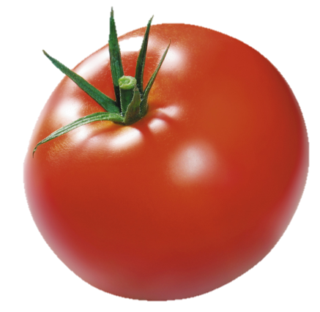
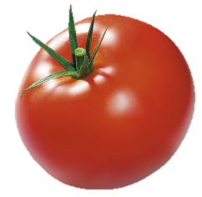
What's the plural of tomato?
GOOD JOB!
one tomato
two
tomatoes
TOMATOES
TOMATOS
TOMATOSES

Slide 7


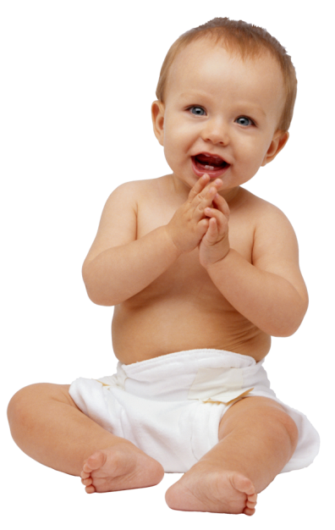
What's the plural of baby?
GOOD JOB!
one baby
two
babies
BABYES
BABYS
BABIES

Slide 8
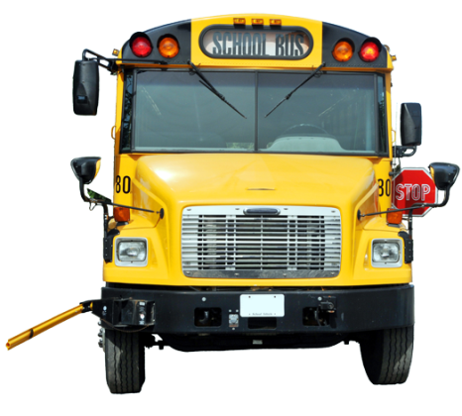
What's the plural of bus?
GOOD JOB!
one bus
two
buses
BUSIES
BUSES
BUSS

Slide 9
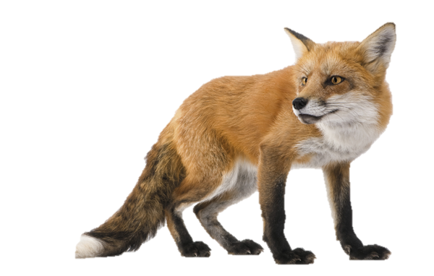
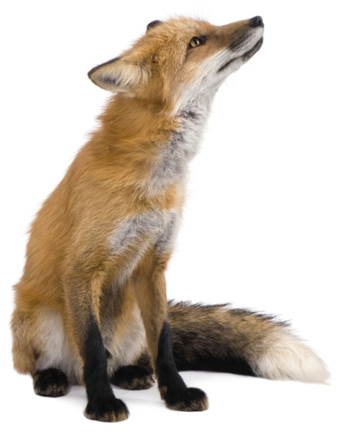
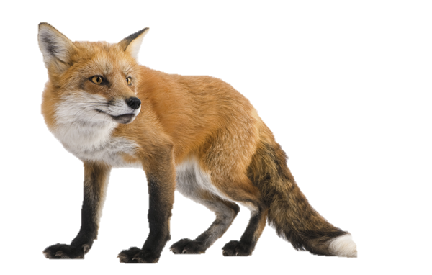
What's the plural of fox?
GOOD JOB!
one fox
two
foxes
FOXS
FOXES
FOXIES

Slide 10
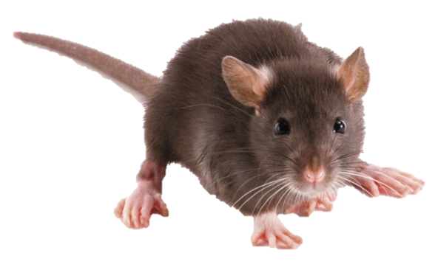

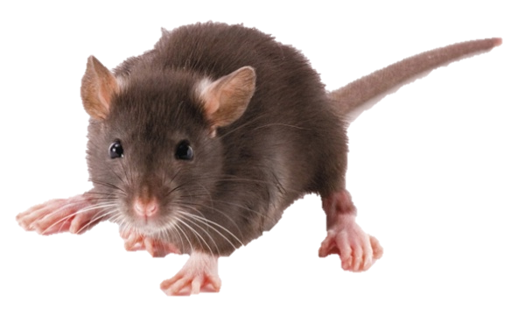
What's the plural of mouse?
GOOD JOB!
two
mice
one mouse
MOUSIES
MICE
MOUSES

Slide 11
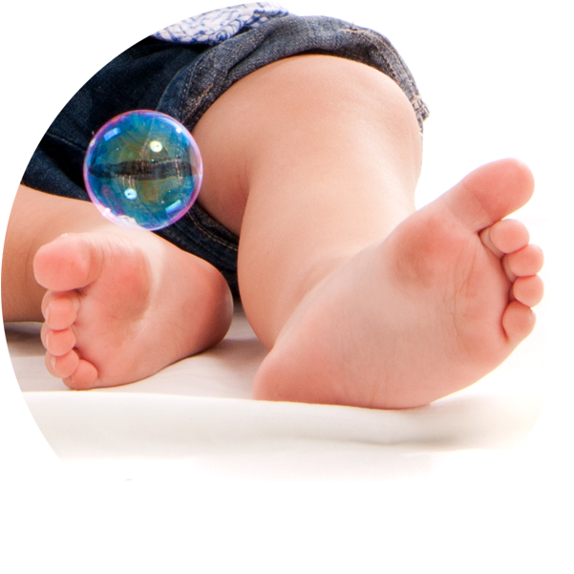
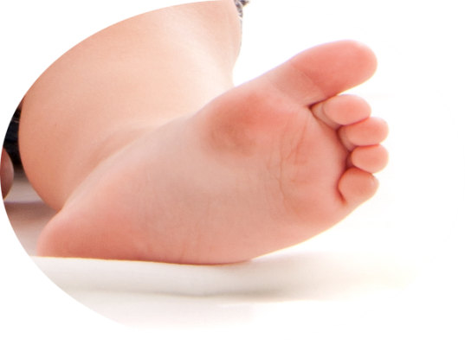
What's the plural of foot?
GOOD JOB!
one foot
feet
two
FOOTIES
FOOTS
FEET

Slide 12


What's the plural of tooth?
GOOD JOB!
one tooth
two
teeth
TOOTHES
TOOTHS
TEETH

Slide 13
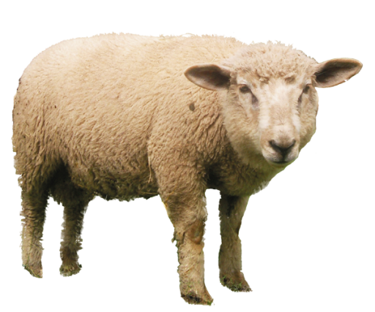

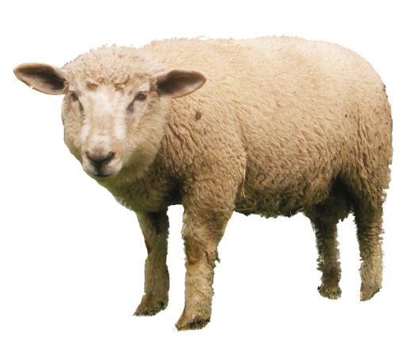
What's the plural of sheep?
GOOD JOB!
one sheep
two
sheep
SHEEP
SHEEPS
SHEEPES

Slide 14
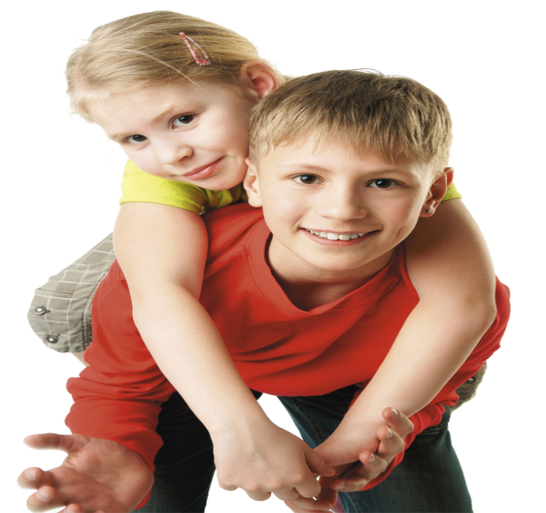
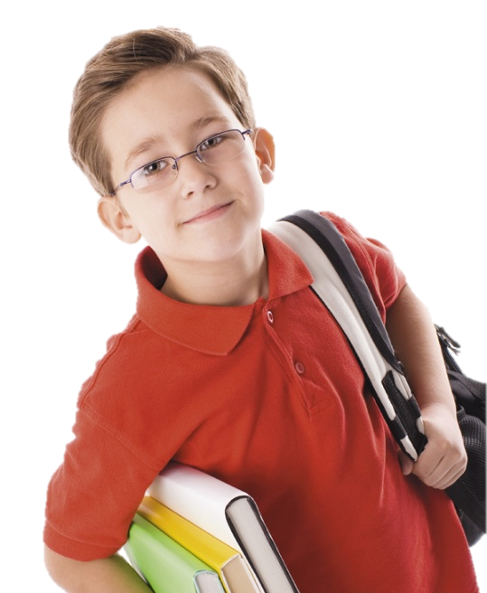
What's the plural of child?
GOOD JOB!
one child
children
two
CHILDREN
CHILDS
CHILDES

Slide 15
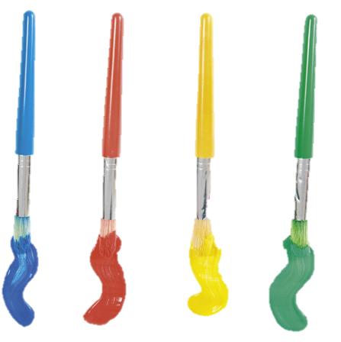
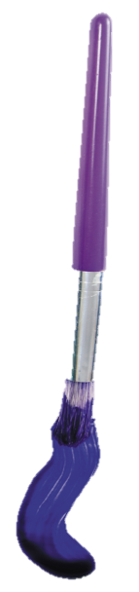
What's the plural of brush?
GOOD JOB!
one brush
some
brushes
BRUSHS
BRUSHES
BRUSHIES

Slide 16
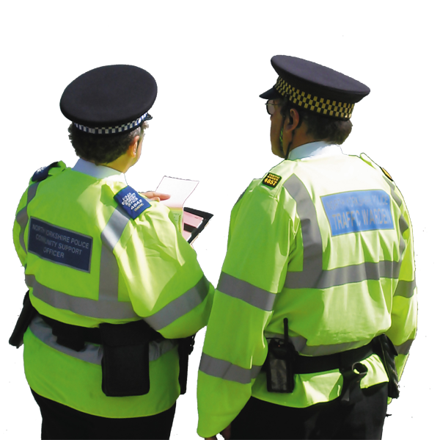
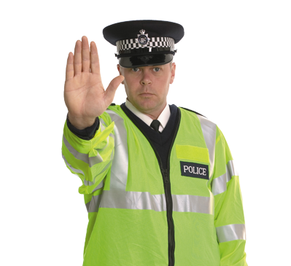
What's the plural of policeman?
GOOD JOB!
one policeman
two
policemen
POLICEMANES
POLICEMANS
POLICEMEN
END

Slide 17
Plural of nouns

