Slide 1

Present Continuous

Slide 2

We use the present continuous to talk about temporary actions or actions happening now, at this moment, today.

Slide 3
Form:
am, is, are
+
main verb + ing

Slide 4
Affirmative
I | am | playing dancing studying
He, she, it | is
We, you, they | are

Slide 5
Interrogative
Am | I | playing? dancing? studying?
Is | he, she, it
Are | we, you, they

Slide 6
Negative
I | am not =´m not | playing dancing studying
he, she, it | is not = isn’t
we, you, they | are not = aren’t

Slide 7
What are these people doing?

Slide 8
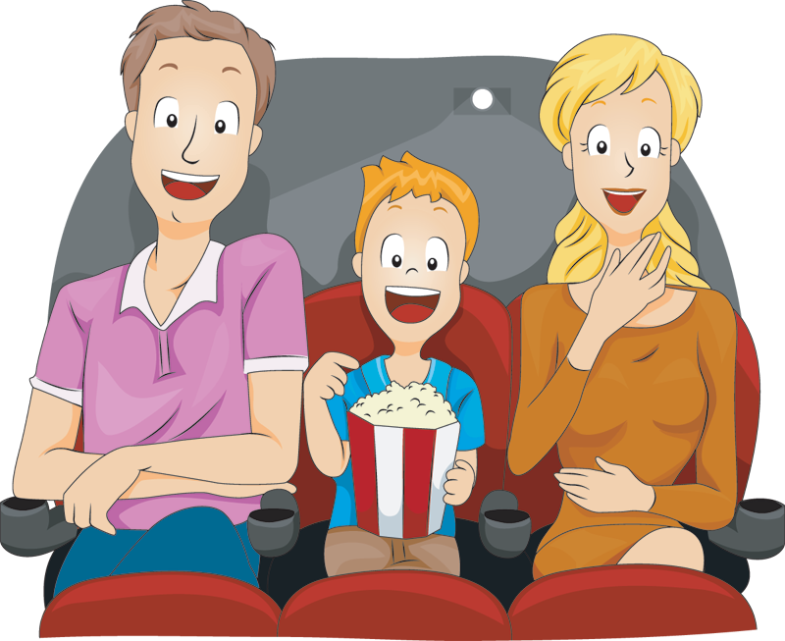

They are watching a film.
He’s reading a book.

Slide 9
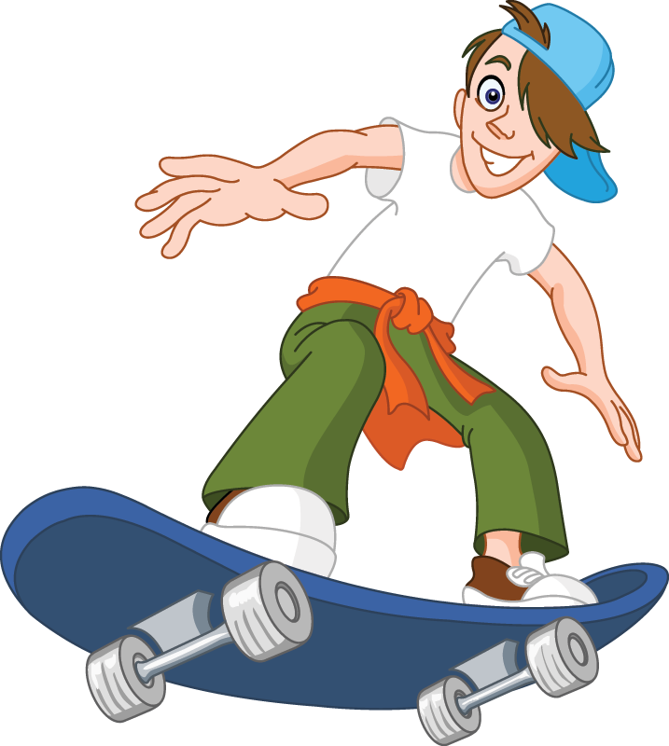

He is skateboarding.
She’s drinking a cup of tea.

Slide 10
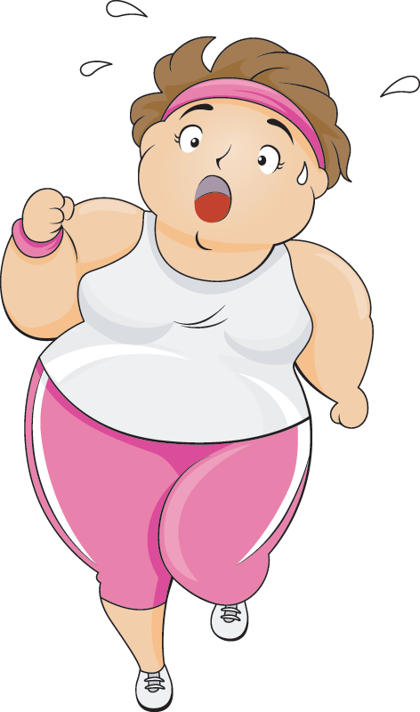
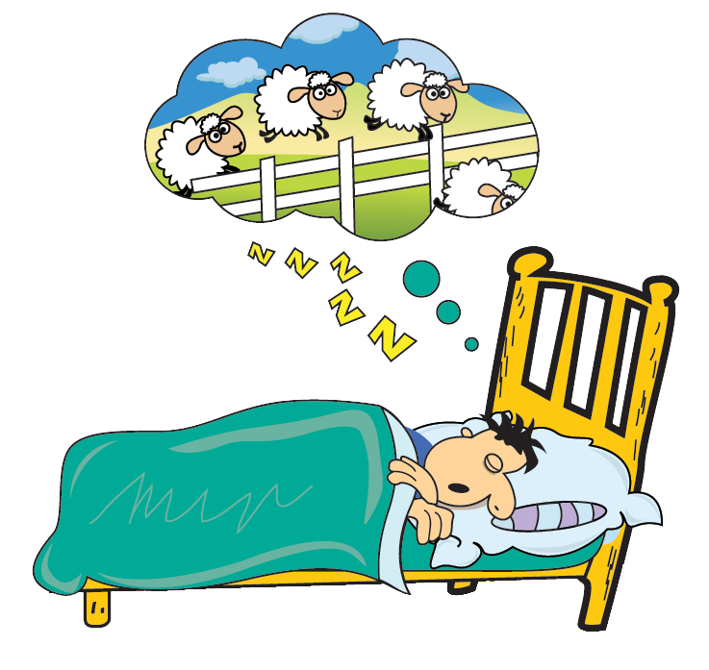
He is sleeping.
She is jogging.

Slide 11
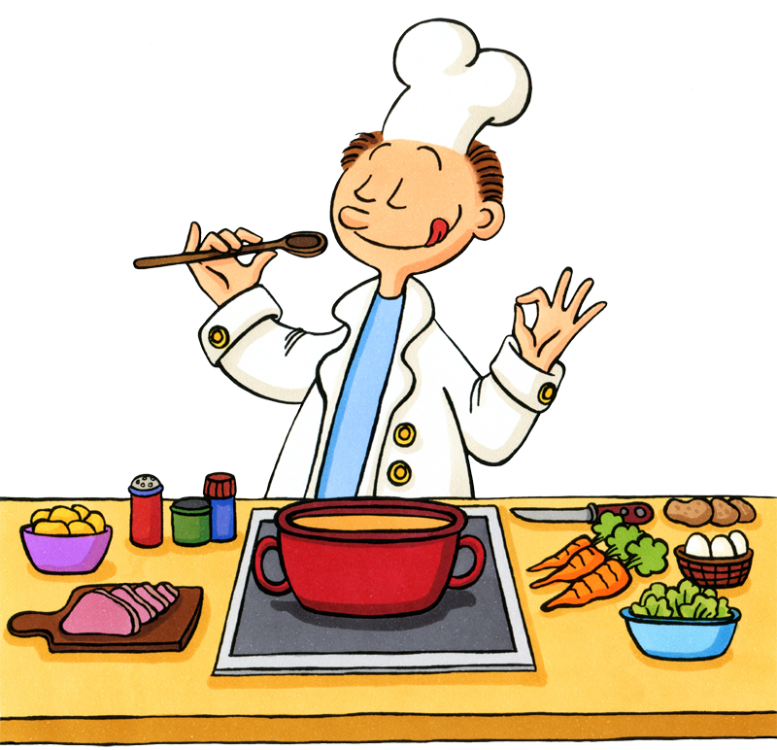

She’s driving.
He’s cooking.

Slide 12
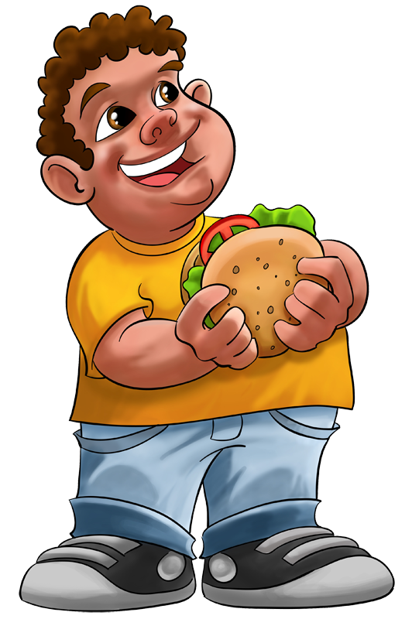

He is eating a burger.
She is singing.

Slide 13
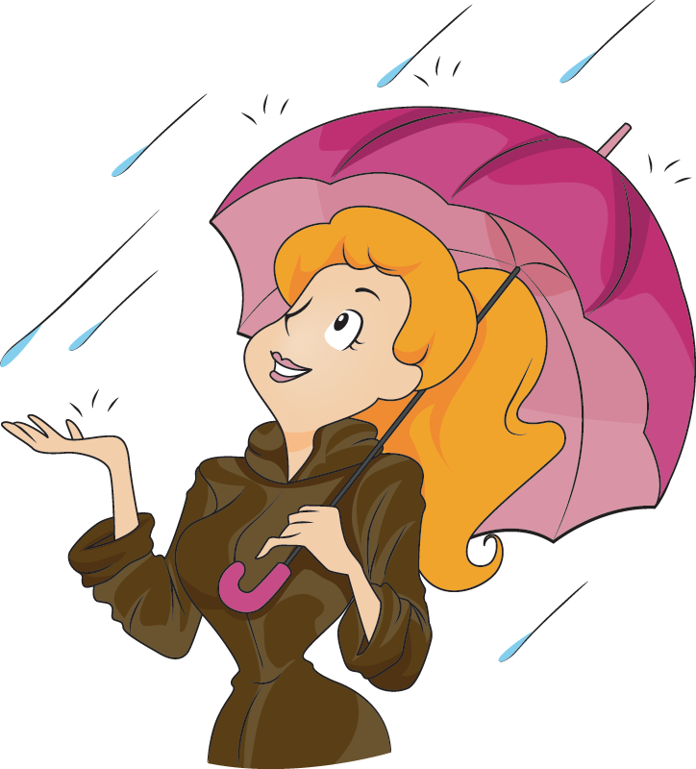
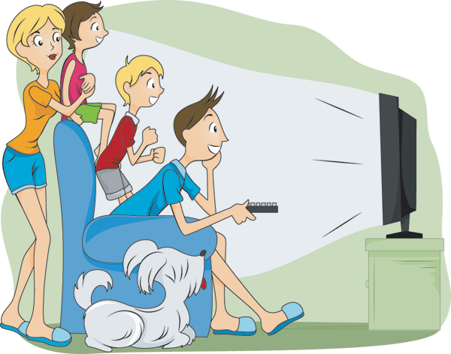
Is it raining?
Yes, it is.
Are they watching TV?
Yes, they are.

Slide 14
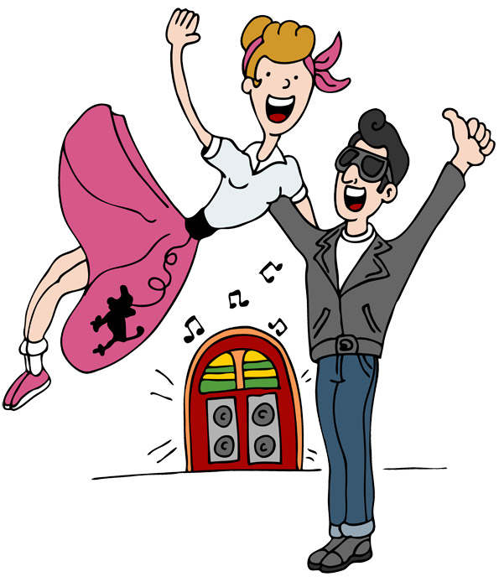
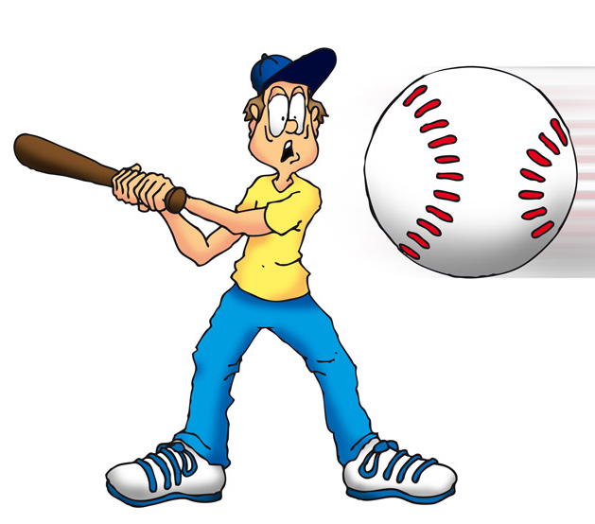
Are they swimming?
Is Peter playing basketball?
No, they aren’t. They are dancing.
No, he isn’t.
He’s playing baseball.

Slide 15
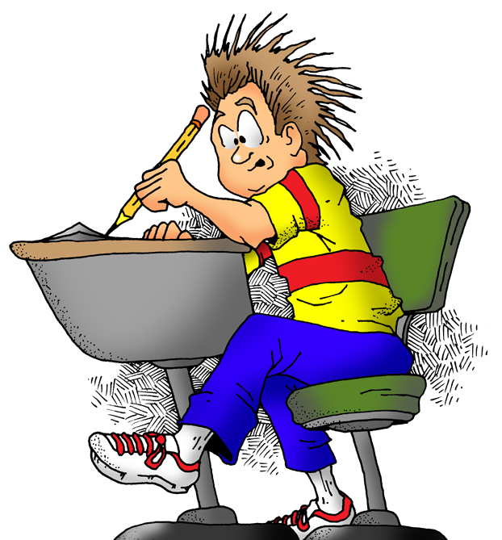

Harry, are you doing the exercises?
Yes, I am, Mr Smith.

Slide 16
Harry, are you playing a game on your phone?
No, I’m not, Mr Smith.

