Slide 1

Present Simple

Slide 2
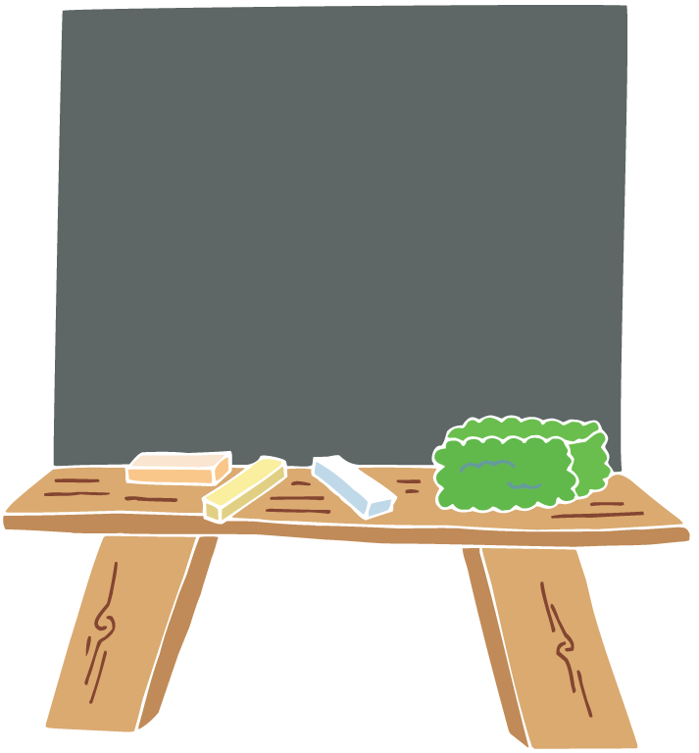
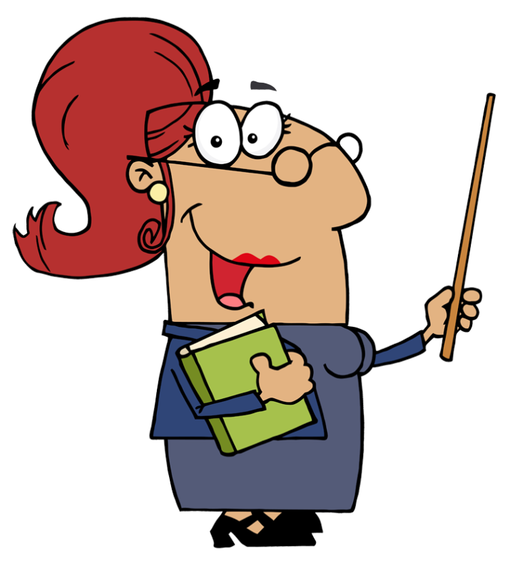
We use the present simple to talk about:
habits, routines or timetables;
universal truths.

Slide 3
ex.
Peter usually gets up at 7.
The train leaves Penzance at 8.15 a.m.
The Earth goes round the sun.

Slide 4
Affirmative
I | play
He, she, it | plays
We, you, they | play

Slide 5
Third person singular: he, she, it
General rule | Verb + s ex. walk – walks
Verbs ending in: o, s, x, ch, sh | Verb + es ex. go – goes watch – watches
Vowel + y | Verb + s ex. buy – buys
Consonant + y | y ies ex. study – studies

Slide 6
Interrogative
Do | I | play? work? like?
Does | he, she, it
Do | we, you, they

Slide 7
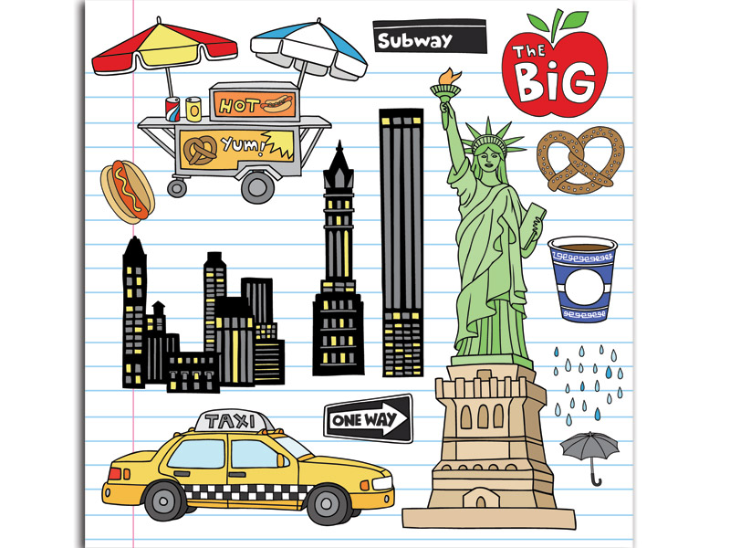
Do they live in New York?
Yes, they do.

Slide 8
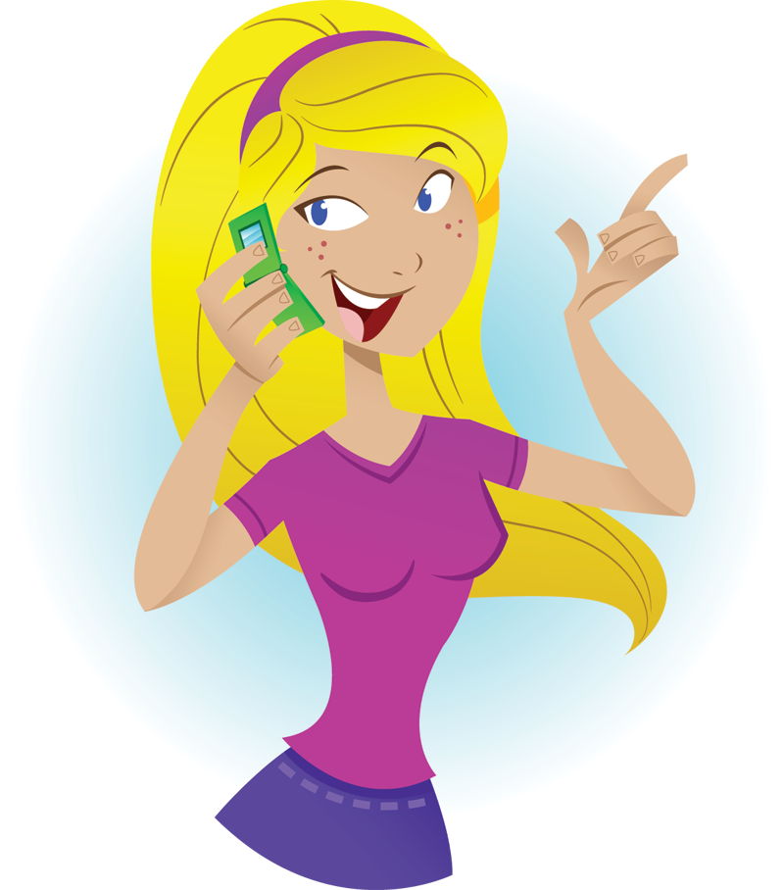
Does she phone her friends every day?
Yes, she does.

Slide 9
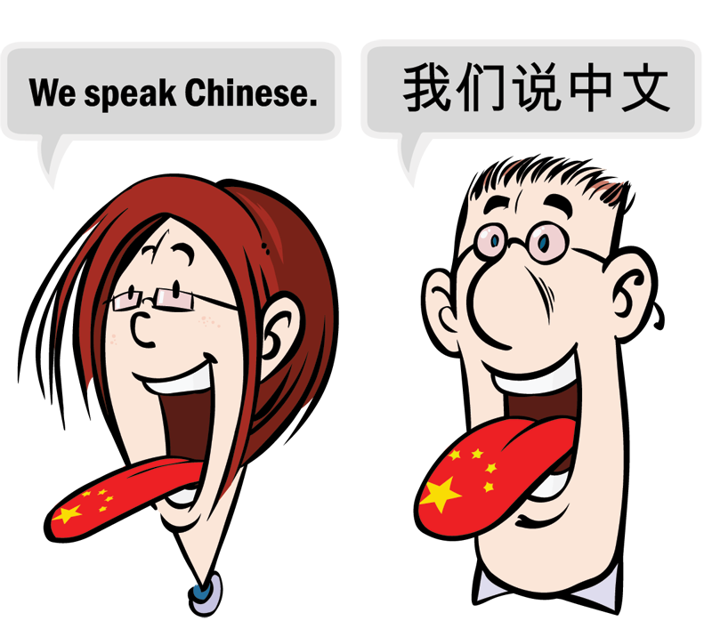
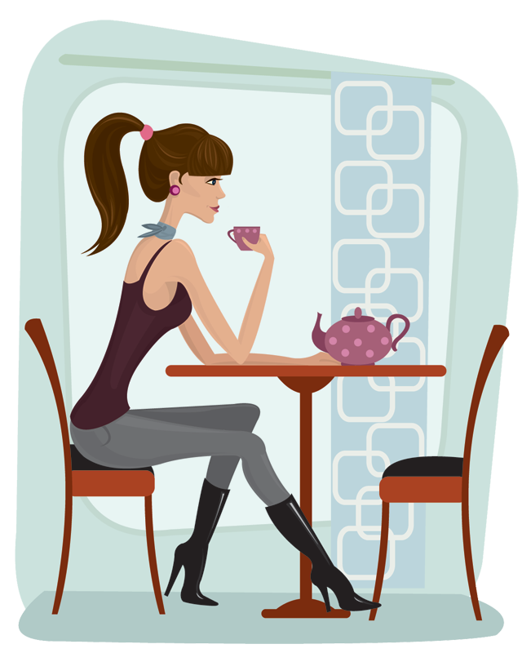
Does she drink coffee in the afternoon?
No, she doesn’t.
Do you speak Chinese?
No, we don’t.

Slide 10
Negative
I | don’t | play work watch
he, she, it | doesn’t
we, you, they | don’t

Slide 11
What do these people do on Saturdays?

Slide 12
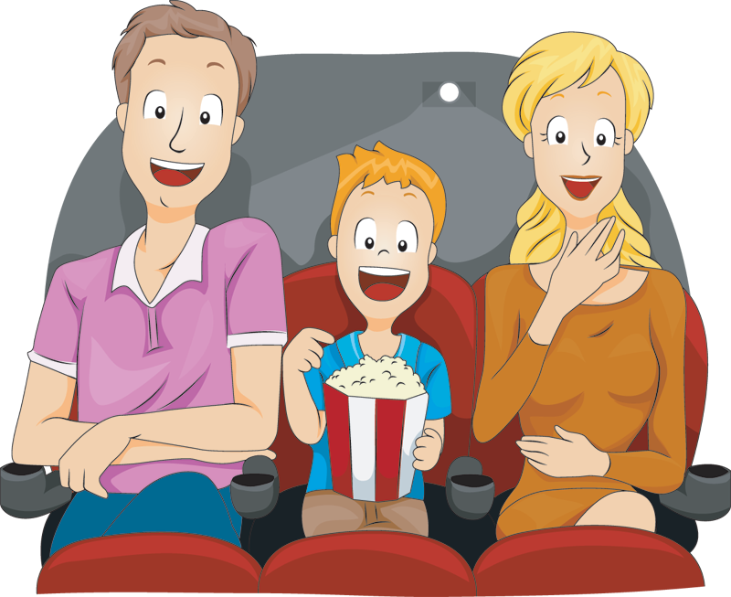
Peter usually to the cinema with his parents.
goes

Slide 13
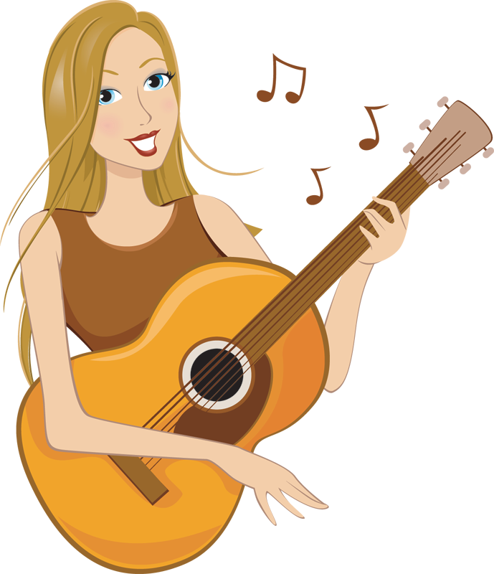

She to music.
listens
She the guitar.
plays

Slide 14
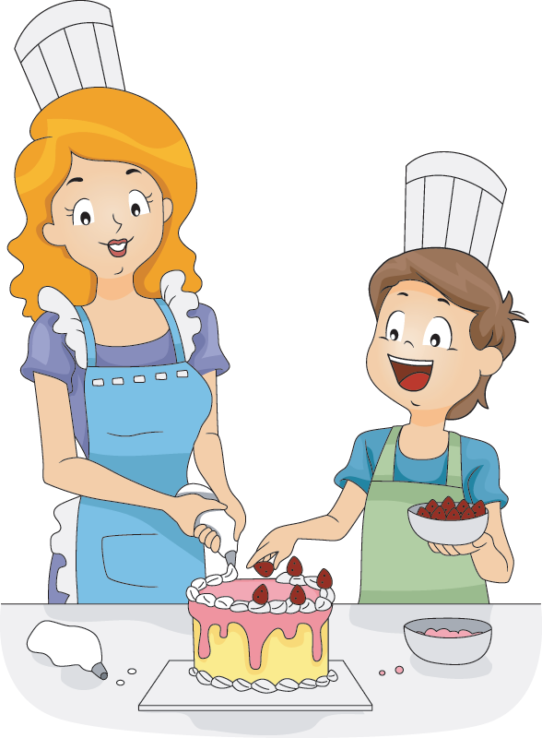
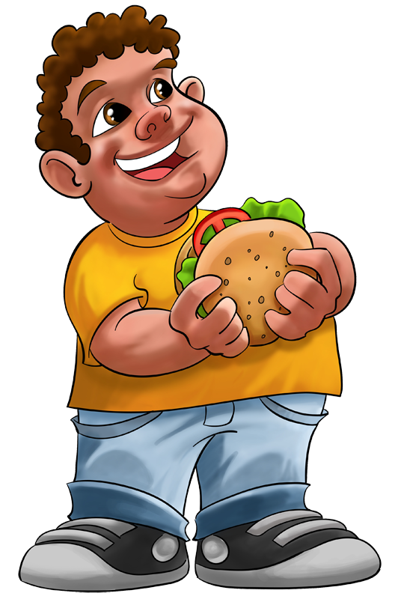
He a burger.
eats
They a cake.
make

Slide 15
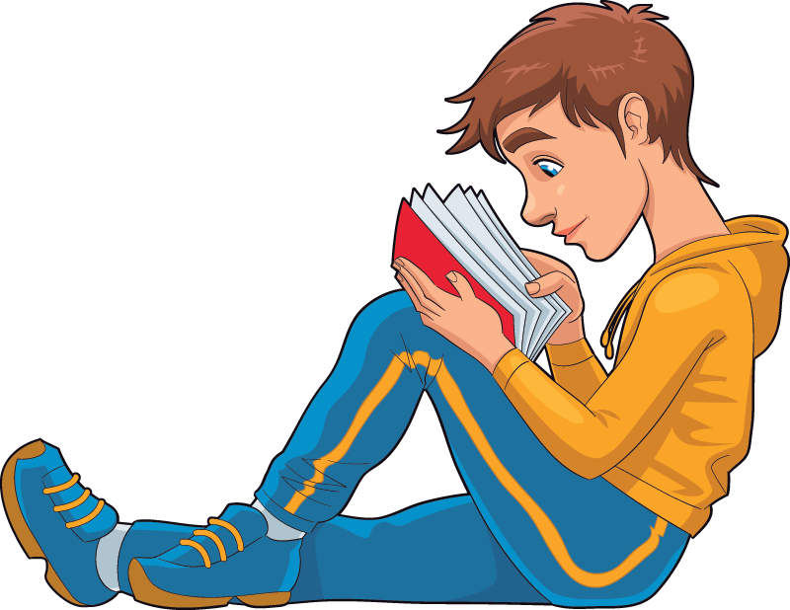

She her car.
drives
He English.
studies

Slide 16
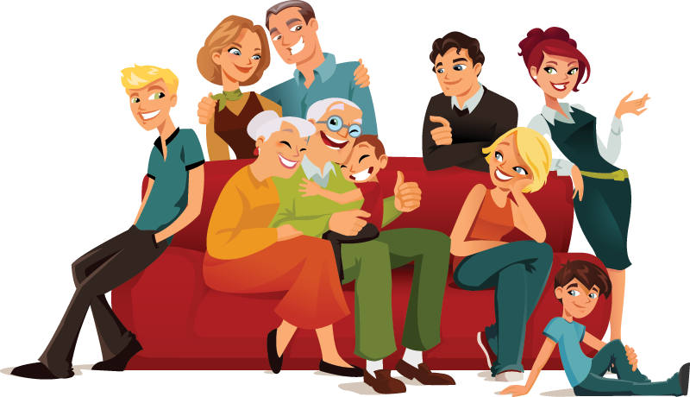

read
They the newspaper.
visit
They their grandparents.

