Slide 1

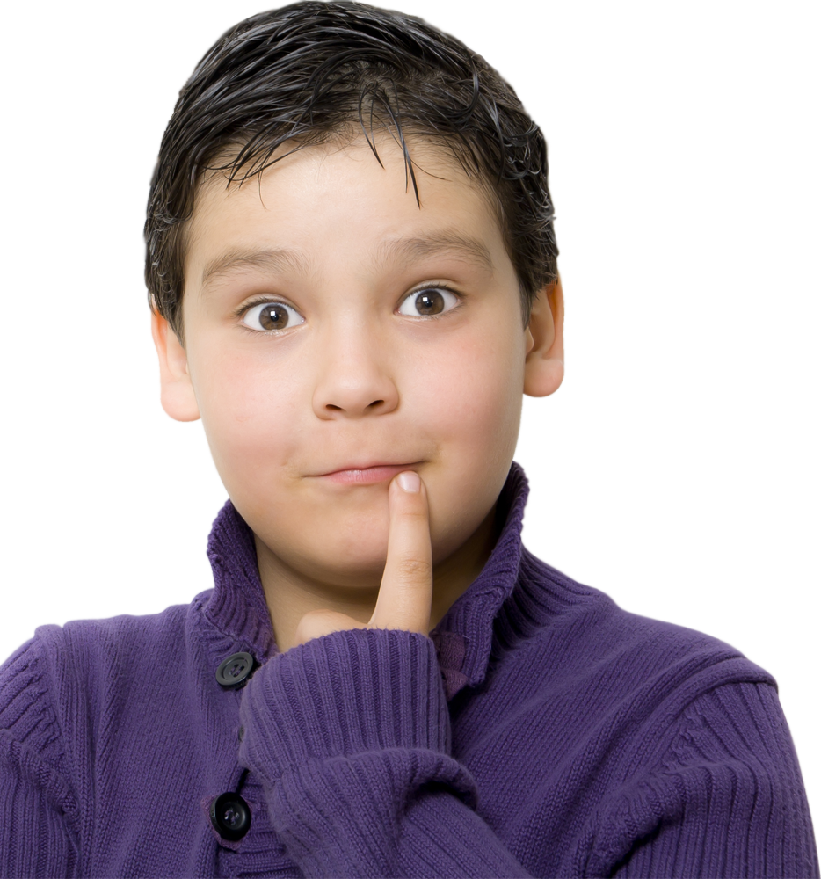

Present Simple
or
Present Continuous?

Slide 2
Present Simple | Present Continuous
We use the present simple to talk about habits, routines, timetables and likes or preferences. ex. We often eat chocolate cake because we really like it. | We use the present continuous to talk about actions happening now or actions that are temporary. ex. At the moment we are eating chocolate cake.
Time expressions
always, often, normally, sometimes, seldom, rarely, never, usually... | At the moment, now, today...

Slide 3

watches
Linda sometimes (watch)
TV after dinner.

Slide 4

Now they (dance).
are dancing

Slide 5
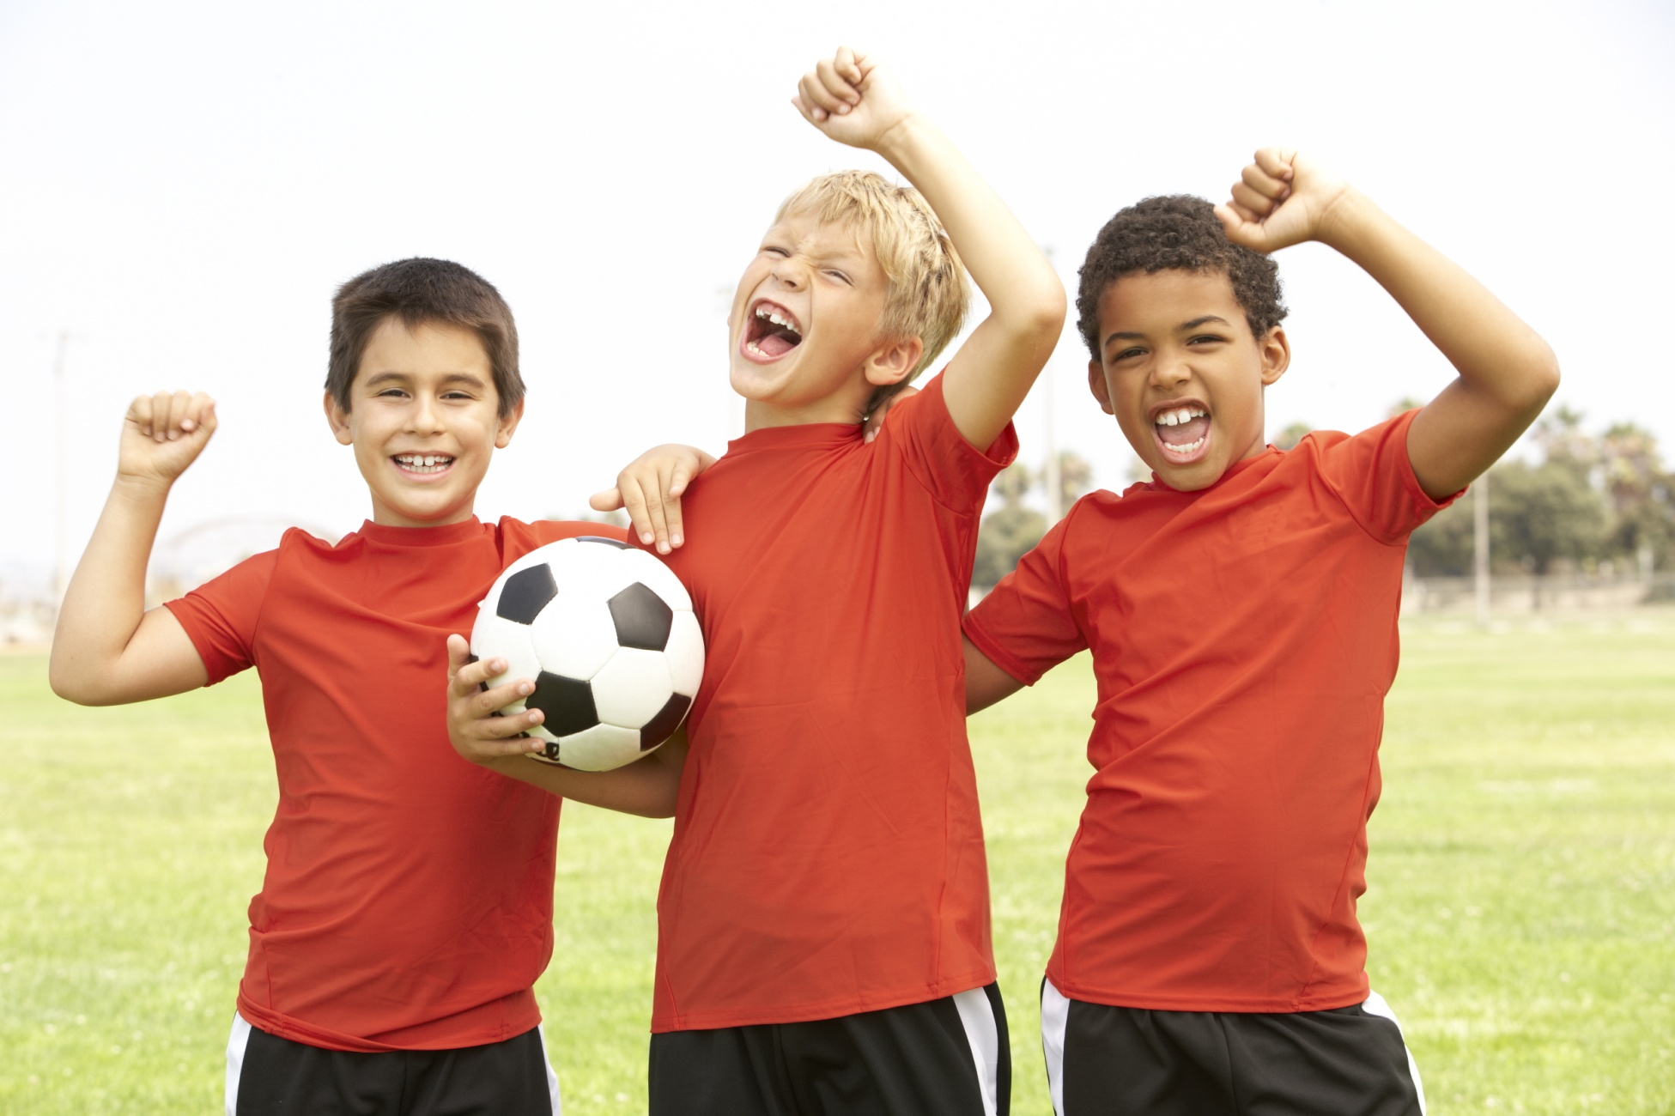
play
They always (play) football
on Sundays.

Slide 6
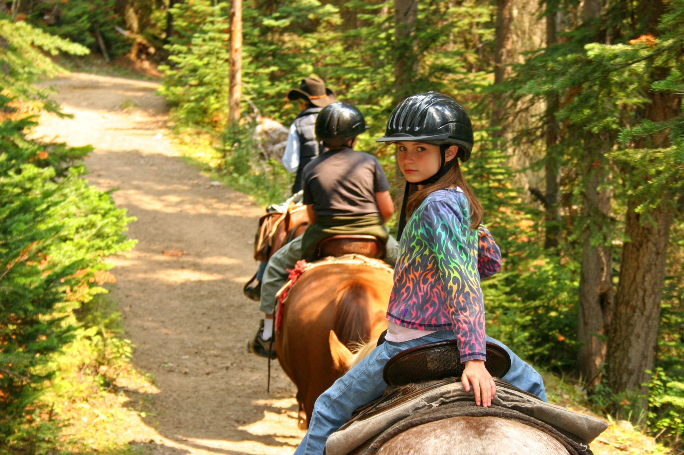
Look! Daisy (ride) a horse.
is riding

Slide 7
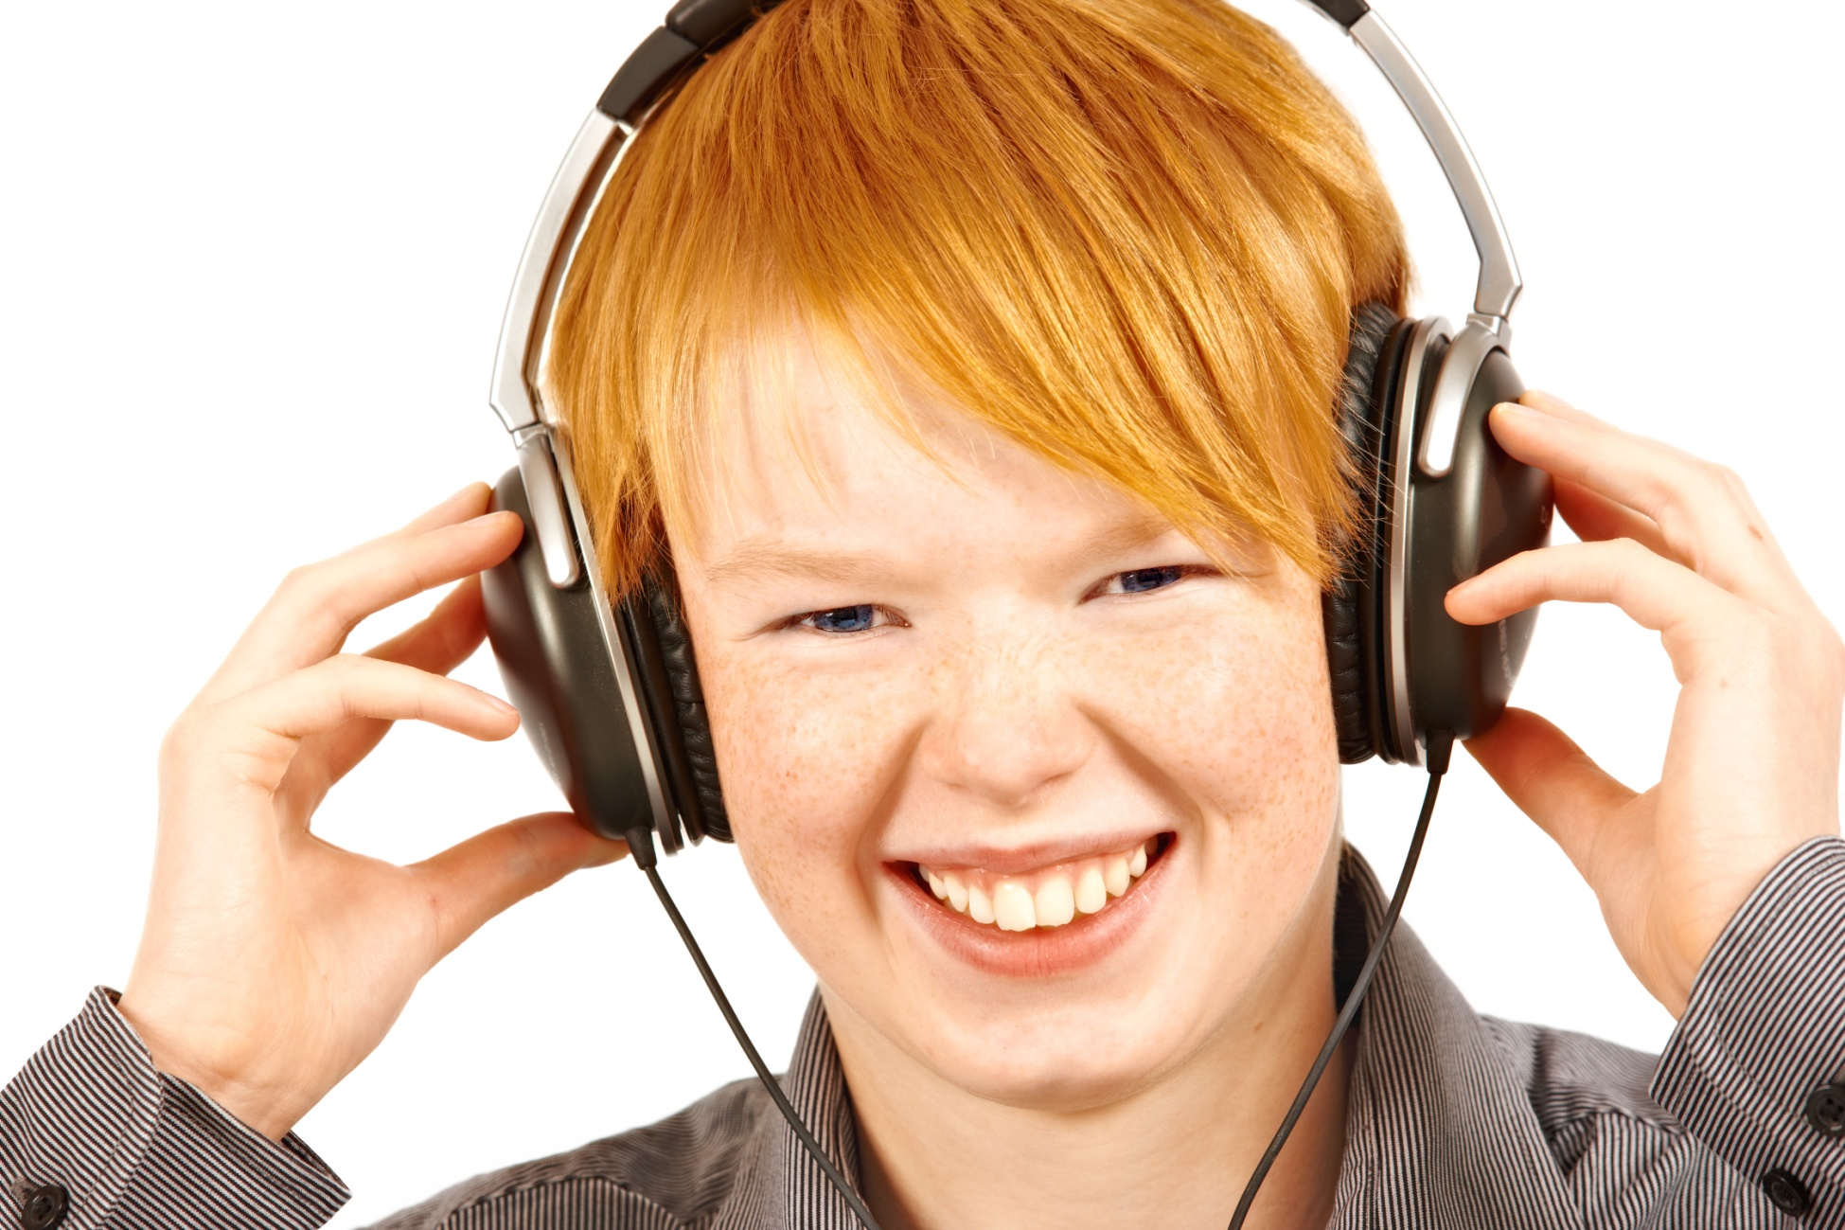
listens to
Tom always (listen to) music before going to bed.

Slide 8
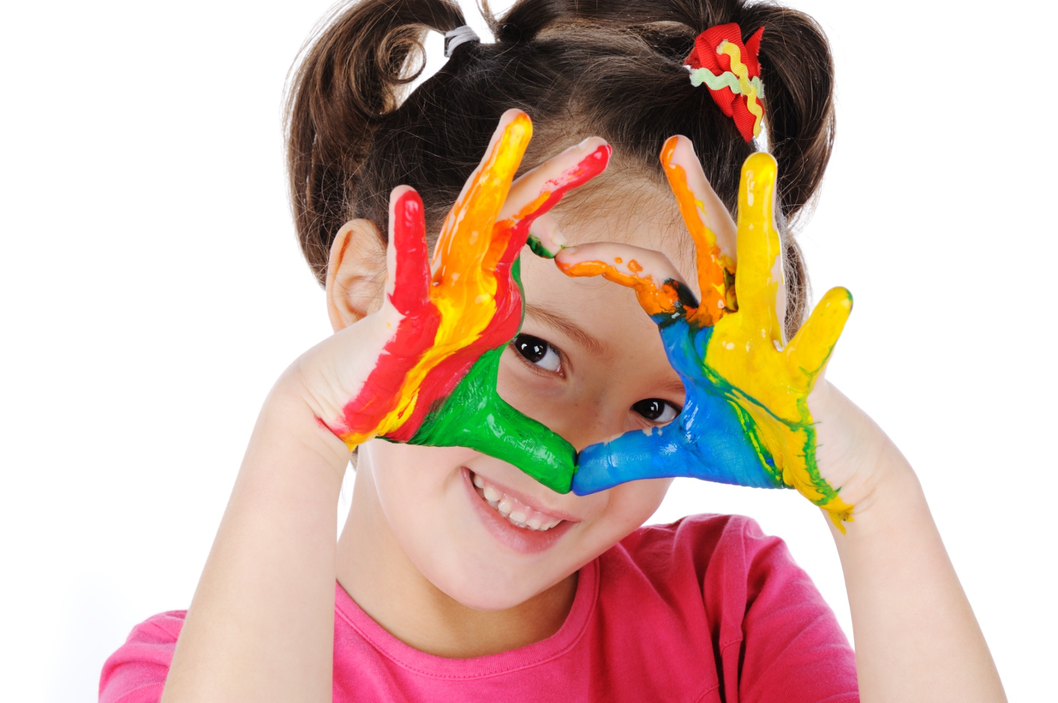
Carol usually (play) games in the afternoon, but today she (paint).
plays
is painting

Slide 9
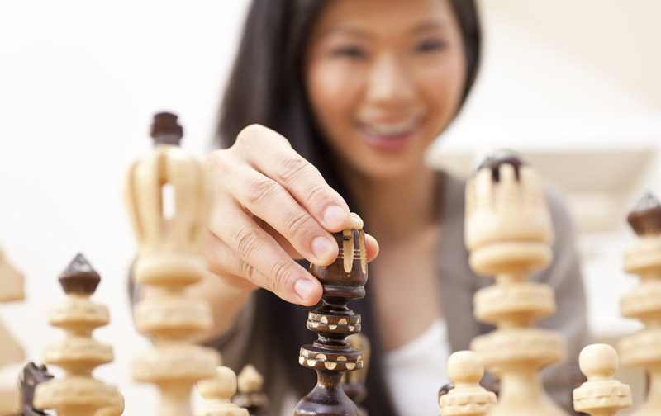
Kim usually (watch) TV in the evening, but today (play) chess.
watches
she is playing

Slide 10
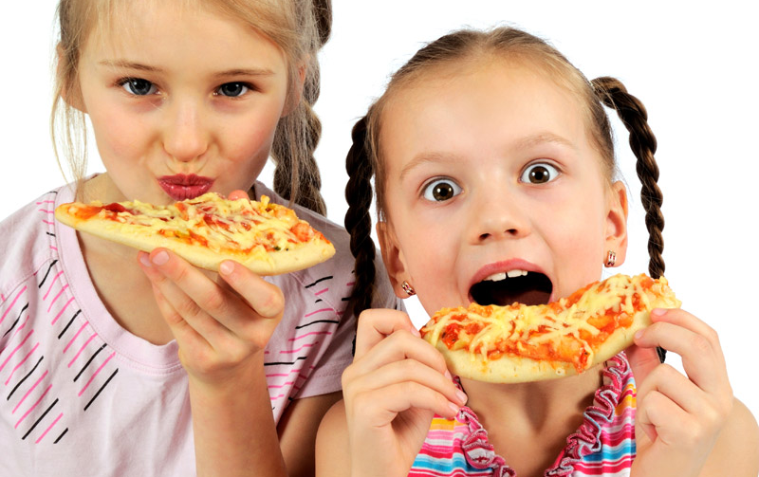
Ann and Sue usually (eat) fish for dinner,
but today they (eat) pizza.
eat
are eating

Slide 11
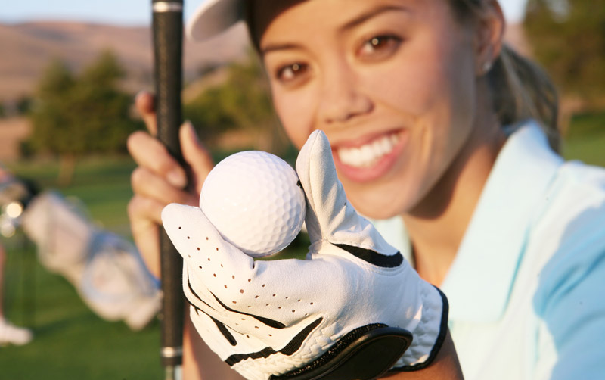
Emily usually (swim) in the sea on Sunday morning , but today she (play) golf.
swims
is playing

Slide 12
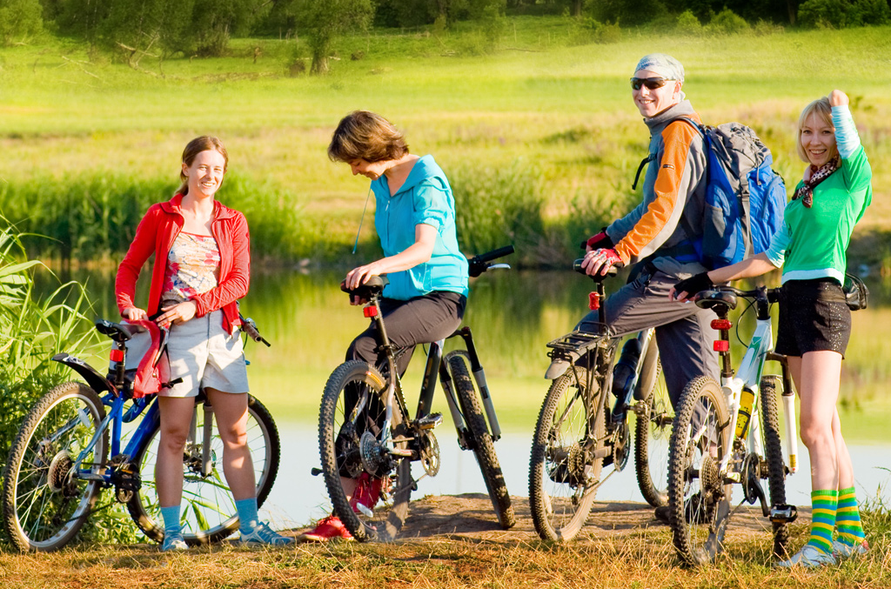
They usually (make) a cake on Saturdays,
but today they (ride) their bikes.
make
are riding

