Slide 1

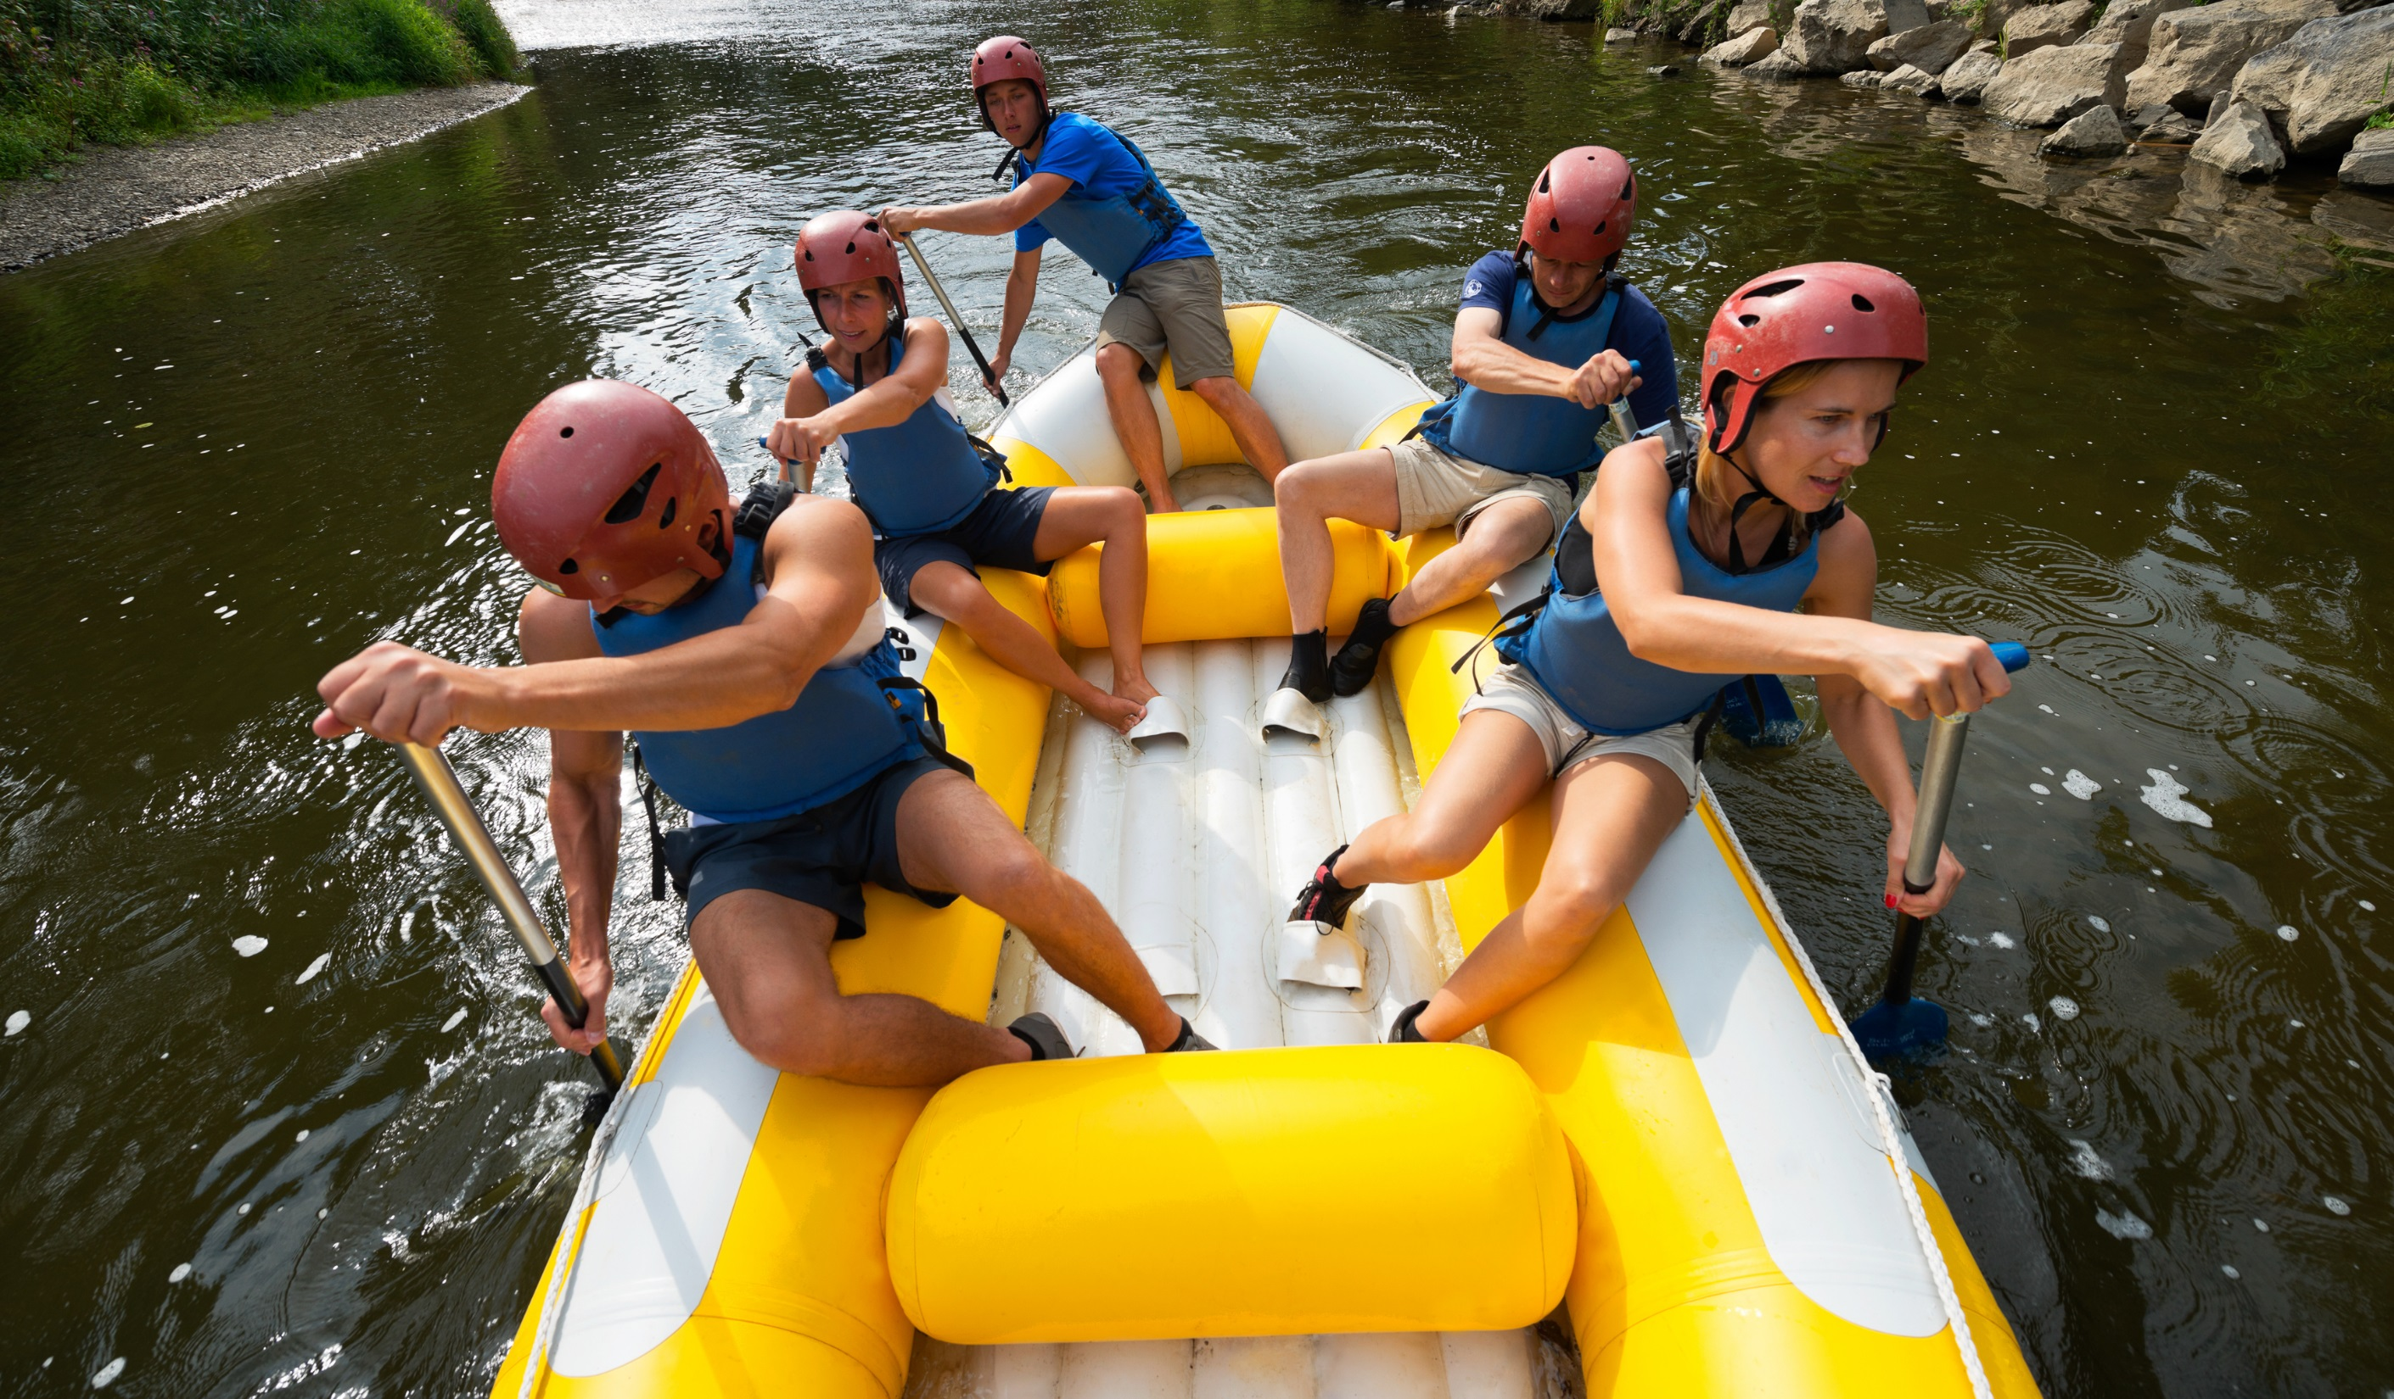
ECO-FRIENDLY SPORTS

Slide 2

How many eco-friendly sports can you memorise?

Slide 3
3

Slide 4
2

Slide 5
1

Slide 6
Parkour
Beach volleyball
Soccer
Golf
Canoeing
Motocross
Jogging
Car racing
Jet-skiing
Paddle board

Slide 7
Was that too fast?
Check your answers!

Slide 8
Parkour
Beach volleyball
Soccer
Golf
Canoeing
Motocross
Jogging
Car racing
Jet-skiing
Paddle board

