Slide 1
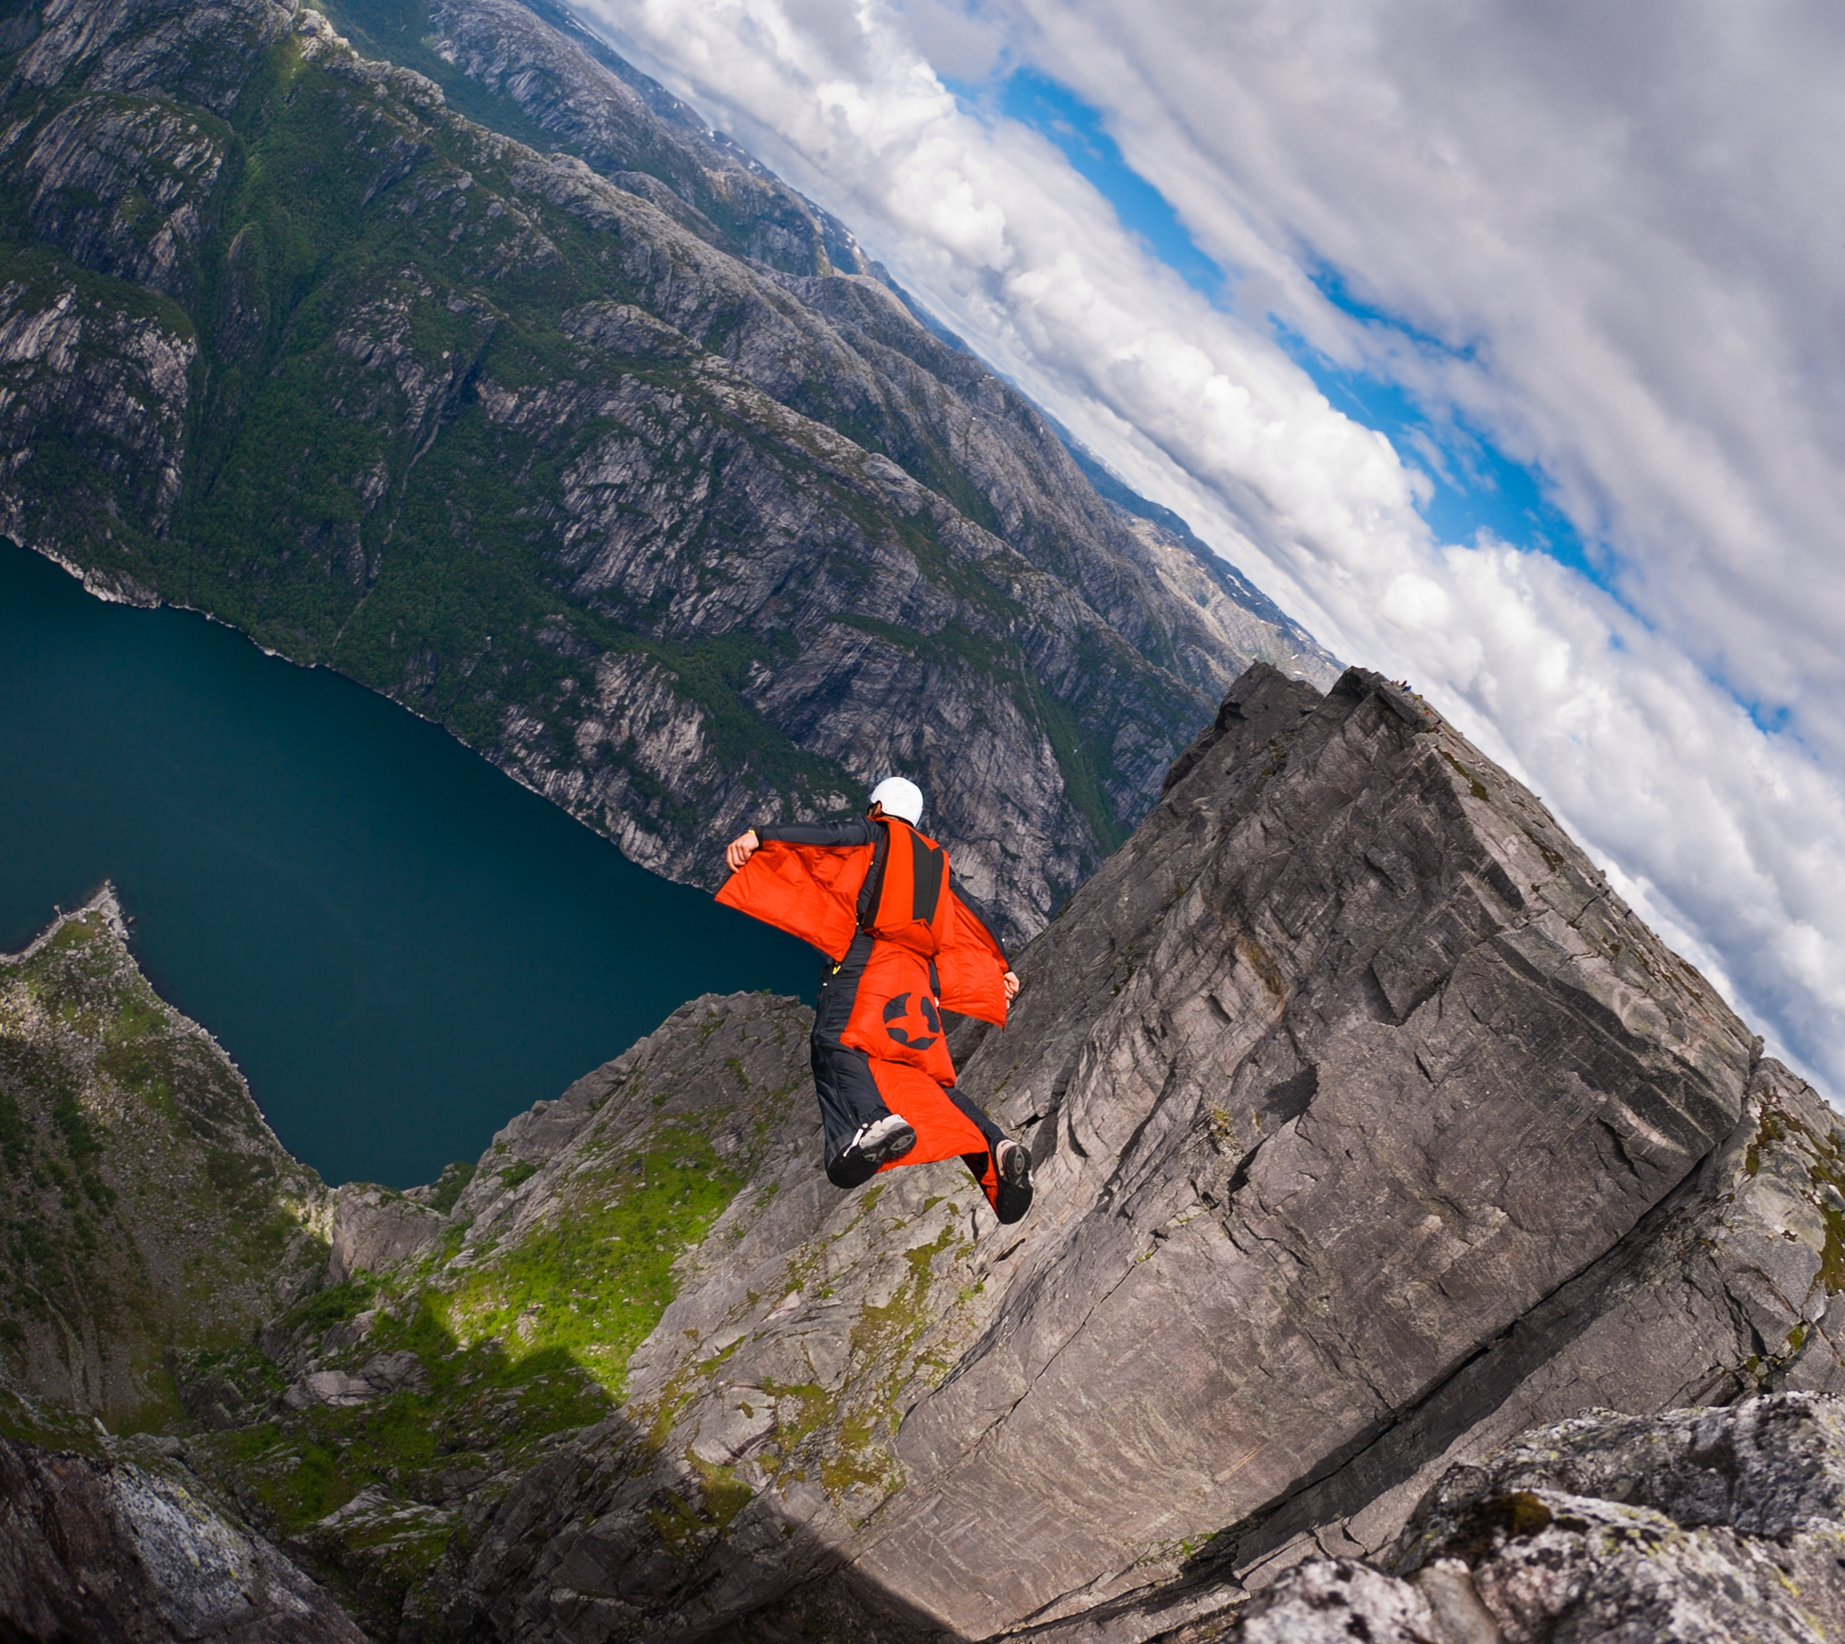
Try to be the first one to guess what’s on the picture.
Use the words given to help you!

Slide 2
glider
jumper
hang
suit
wing
bird
delta
fly

Slide 3
wing
suit
jumper
glider
hang
bird
delta
fly

