Slide 1

POLE
POSITION
POLE
POSITION
POLE
POSITION
This is a race between a green and a red car. Choose yours and answer the questions!

Slide 2
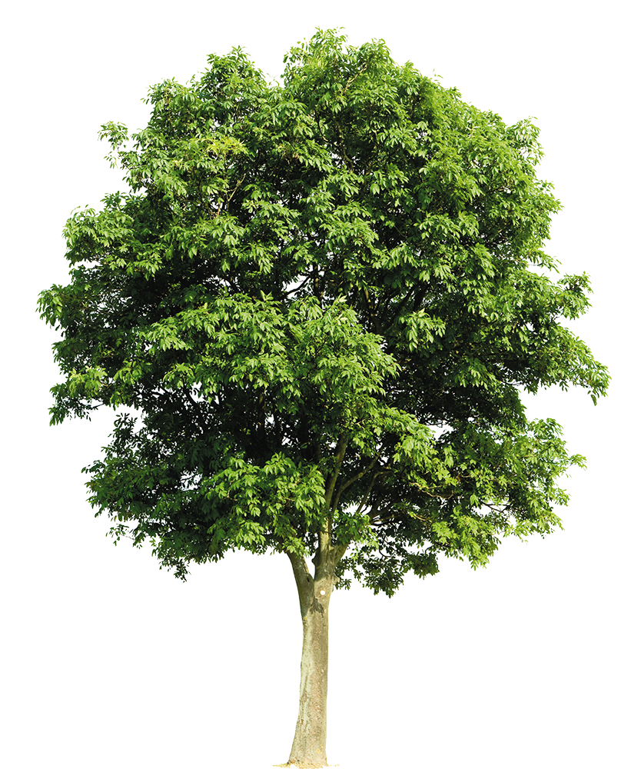




Green car, choose the correct sentence!
A. Jonathan is healthier my sister.
B. Jonathan is healthier than my sister.
C. Jonathan is healthiest my sister.

Slide 3
Green car, choose the correct sentence!
A. Jonathan is healthier my sister.
B. Jonathan is healthier than my sister.
C. Jonathan is healthiest my sister.
GREEN CAR, YOU WON!
NEXT

Slide 4
Green car, choose the correct sentence!
A. Jonathan is healthier my sister.
B. Jonathan is healthier than my sister.
C. Jonathan is healthiest my sister.
GREEN CAR, YOU LOST!
TRY AGAIN

Slide 5
Red car, choose the correct sentence.
A. Who is the fitter person in this class?
B. Who is the fittest person in this class?
C. Who is fittest person in this class?

Slide 6
Red car, choose the correct sentence.
A. Who is the fitter person in this class?
B. Who is the fittest person in this class?
C. Who is fittest person in this class?
RED CAR, YOU WON!
NEXT

Slide 7
Red car, choose the correct sentence.
A. Who is the fitter person in this class?
B. Who is the fittest person in this class?
C. Who is fittest person in this class?
RED CAR, YOU LOST!
TRY AGAIN

Slide 8
Green car, choose the correct sentence!
A. Jamie Oliver’s food is tastier mine.
B. Jamie Oliver’s food is tastier as mine.
C. Jamie Oliver’s food is tastier than mine.

Slide 9
Green car, choose the correct sentence!
A. Jamie Oliver’s food is tastier mine.
B. Jamie Oliver’s food is tastier as mine.
C. Jamie Oliver’s food is tastier than mine.
GREEN CAR, YOU WON!
NEXT

Slide 10
Green car, choose the correct sentence!
A. Jamie Oliver’s food is tastier mine.
B. Jamie Oliver’s food is tastier as mine.
C. Jamie Oliver’s food is tastier than mine.
GREEN CAR, YOU LOST!
TRY AGAIN

Slide 11
Red car, choose the correct sentence.
A. My health gets worse as I eat more junk food.
A. My health gets worse than I eat more junk food.
A. My health gets more worse as I eat more junk food.

Slide 12
Red car, choose the correct sentence.
A. My health gets worse as I eat more junk food.
A. My health gets worse than I eat more junk food.
A. My health gets more worse as I eat more junk food.
RED CAR, YOU WON!

Slide 13
Red car, choose the correct sentence.
A. My health gets worse as I eat more junk food.
A. My health gets worse than I eat more junk food.
A. My health gets more worse as I eat more junk food.
RED CAR, YOU LOST!
TRY AGAIN

