Slide 1

POLE
POSITION
POLE
POSITION
POLE
POSITION
This is a race between a green and a red car. Choose yours and answer the questions!

Slide 2
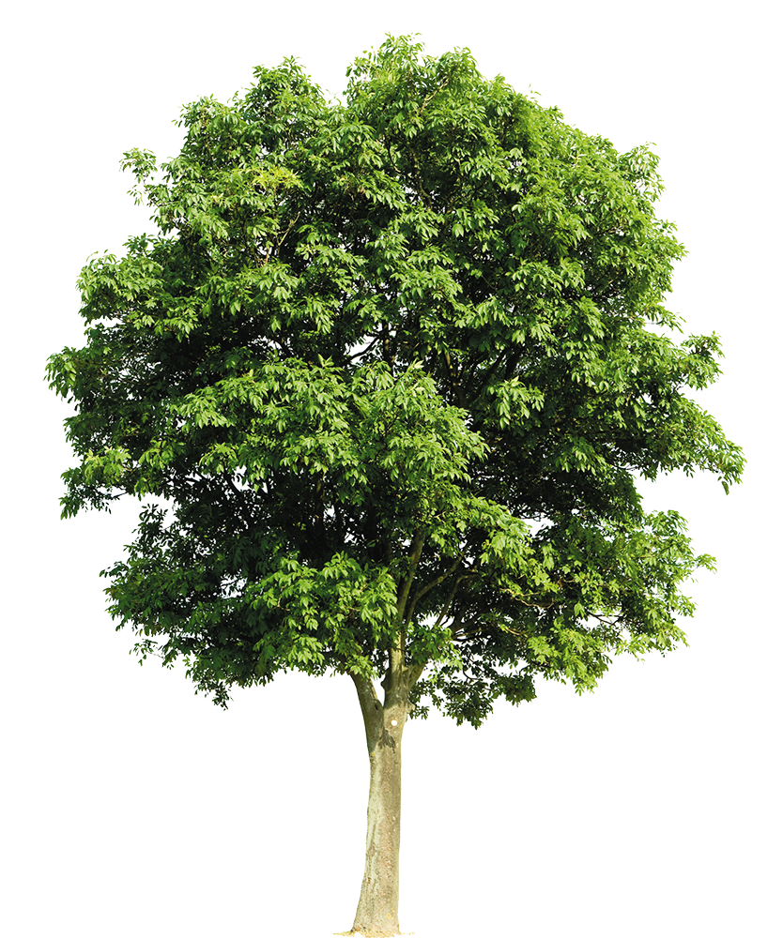




Green car, choose the correct sentence!
A. I have yet met Richard last week.
B. I have already met Richard last week.
C. I have never met Richard last week.

Slide 3
Green car, choose the correct sentence!
A. I have yet met Richard last week.
B. I have already met Richard last week.
C. I have never met Richard last week.
GREEN CAR, YOU WON!
NEXT

Slide 4
Green car, choose the correct sentence!
A. I have yet met Richard last week.
B. I have already met Richard last week.
C. I have never met Richard last week.
GREEN CAR, YOU LOST!
TRY AGAIN

Slide 5
Red car, choose the correct sentence.
A. Have you ever gone to that cinema?
B. Have you yet gone to that cinema?
C. Have ever you gone to that cinema?

Slide 6
Red car, choose the correct sentence.
A. Have you ever gone to that cinema?
B. Have you yet gone to that cinema?
C. Have ever you gone to that cinema?
RED CAR, YOU WON!
NEXT

Slide 7
Red car, choose the correct sentence.
A. Have you ever gone to that cinema?
B. Have you yet gone to that cinema?
C. Have ever you gone to that cinema?
RED CAR, YOU LOST!
TRY AGAIN

Slide 8
Green car, choose the correct sentence!
A. He’s never saw Brad.
B. He never is seen Brad.
C. He’s never seen Brad.

Slide 9
Green car, choose the correct sentence!
A. He’s never saw Brad.
B. He never is seen Brad.
C. He’s never seen Brad.
GREEN CAR, YOU WON!
NEXT

Slide 10
Green car, choose the correct sentence!
A. He’s never saw Brad.
B. He never is seen Brad.
C. He’s never seen Brad.
GREEN CAR, YOU LOST!
TRY AGAIN

Slide 11
Red car, choose the correct sentence.
A. I haven’t finished the book yet.
B. I have finished the book yet.
C. I have yet finished the book.

Slide 12
Red car, choose the correct sentence.
A. I haven’t finished the book yet.
B. I have finished the book yet.
C. I have yet finished the book.
RED CAR, YOU WON!

Slide 13
Red car, choose the correct sentence.
A. I haven’t finished the book yet.
B. I have finished the book yet.
C. I have yet finished the book.
RED CAR, YOU LOST!
TRY AGAIN

