Slide 1

SPACE ATTACK
SHOOT THE IRREGULAR VERBS!
START

Slide 2
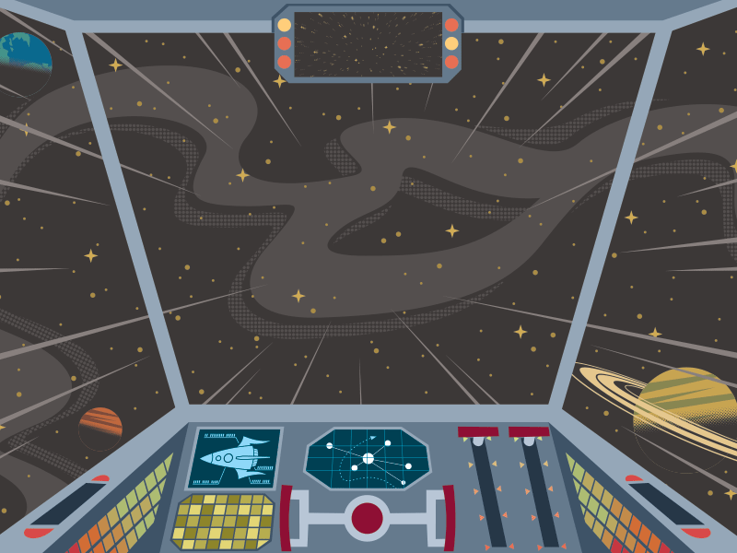

Slide 3
find
travel
forget
touch
ring
write
set
fall
paint
kiss

