Slide 1

SPACE ATTACK
SHOOT THE CORRECT EXPRESSIONS
START

Slide 2
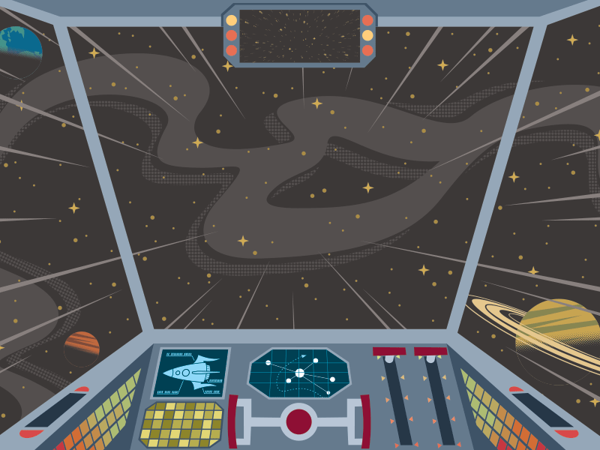

Slide 3
so classmates
many time
few friends
many children
Many so problems
so thin
so delicious
many water
so little food

