Slide 1

SPACE ATTACK
SHOOT THE CORRECT SENTENCES
START

Slide 2
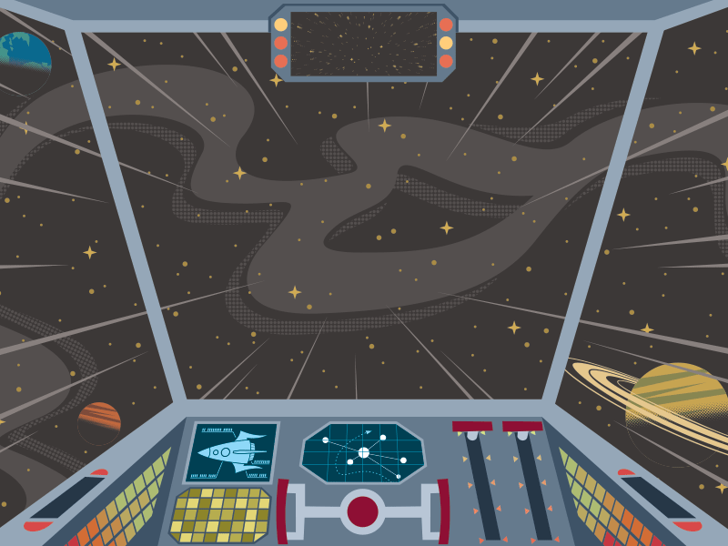

Slide 3
Next week I’m going to visit my friends.
Next week I will going to visit my friends.

Slide 4
I think I’m going to buy a tablet for Christmas.
I think I will buy a tablet for Christmas.

Slide 5
Don’t move! I’m going to help you get up!
Don’t move! I’ll help you get up!

Slide 6
Do you think we will have time?
Do you think we’re going to have time?

Slide 7
Tomorrow she’s going to do some research.
Tomorrow she’ll do some research.

Slide 8
Next year I’m going to be 14 years old.
Next year I will be 14 years old.

Slide 9
They believe tablets will replace books.
They believe tablets are going to replace books.

