Slide 1

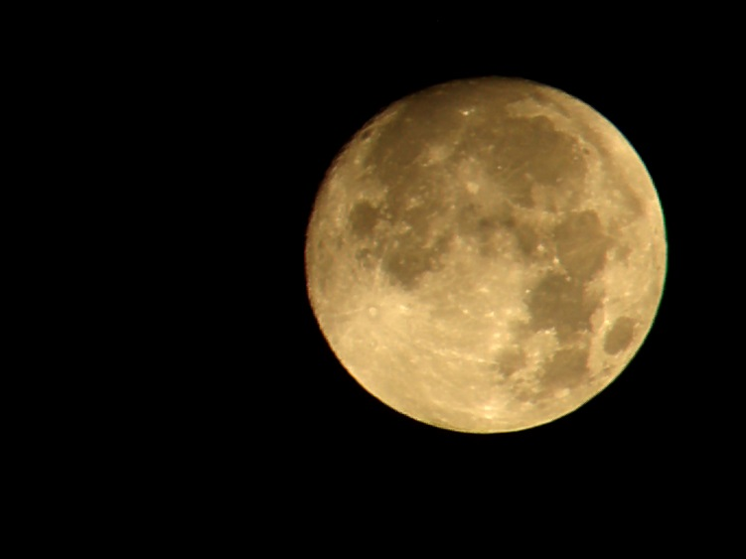


Slide 2
What’s the Twilight saga really about?
Aliens invading Earth
B
A
Wolves and Vampires
A new Human race.
Relationship between Bella and Edward.
C
D

Slide 3
What’s the name of the second movie of the Twilight saga?
New Moon
B
A
Eclipse
Breaking Dawn
Divergent
C
D

Slide 4
What’s the name of the actress that plays Bella?
Melissa Rosenberg
B
A
Stephenie Meyer
Kristen Stewart
Alexandra Burwell
C
D

Slide 5
Who is Jacob?
Edward’s best friend
B
A
He’s a werewolf and Bella’s friend.
One of the most feared vampires.
Bella’s father.
C
D

Slide 6
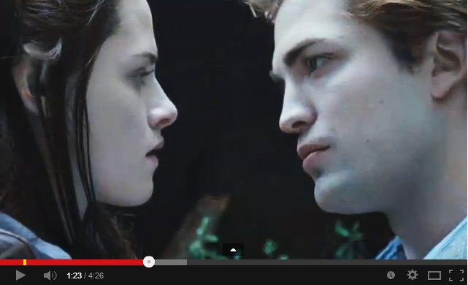
Watch the Twilight’s trailer before you answer the next questions.

Slide 7
Which one of the following questions does Edward ask Bella?
What if I’m the hero?
B
A
What if I put you in danger?
What if we’re meant to be together?
What if I’m the bad guy?
C
D

Slide 8
Who got killed by an “animal”?
Student
B
A
Security Guard
Police officer
Vampire
C
D

Slide 9
What will Edward do to make Bella safe?
He will hide her.
B
A
He will stop seeing her.
He will do whatever it takes.
He will ask the other vampire to stop.
C
D

